Slide 1
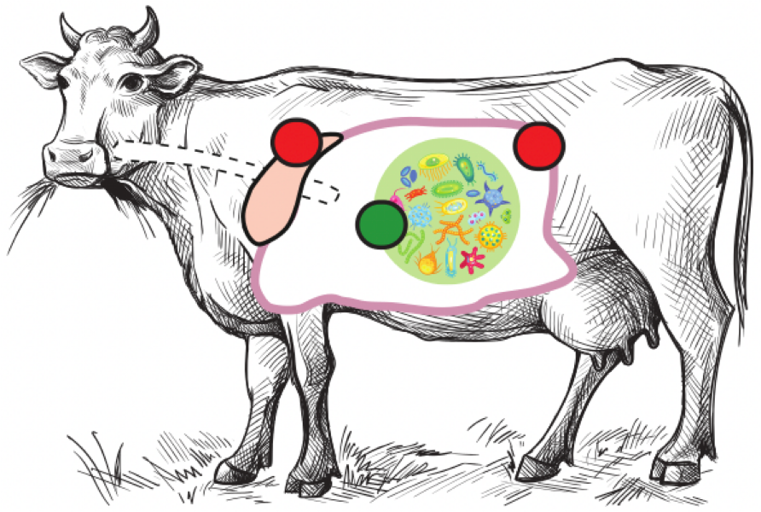



Rumen Holo-omics
& The Microbiome Split
Carl Mathias Kobel, PhD student from Scandinavia
The Microbial Ecology and Meta-Omics group (MEMO)
Norwegian University of Life Sciences (NMBU)
In collaboration with Centre for Microbiome Research, QUT, Woolloongabba, Australia
Notes:
(Pre-start standby slide.)
-

Slide 2
Rumen Holo-omics
& The Microbiome Split
Carl Mathias Kobel, PhD student from Scandinavia
The Microbial Ecology and Meta-Omics group (MEMO)
Norwegian University of Life Sciences (NMBU)
In collaboration with Centre for Microbiome Research, QUT, Woolloongabba, Australia
Notes:
(Start)
Hello. Thanks for giving me the opportunity to talk here today.
I'm Carl, I'm Danish. I'm a PhD student from the MEMO group at NMBU in Norway.
Today I will present a state-of-the-art multi-omic holo-omic high resolution rumen based project.
-

Slide 3
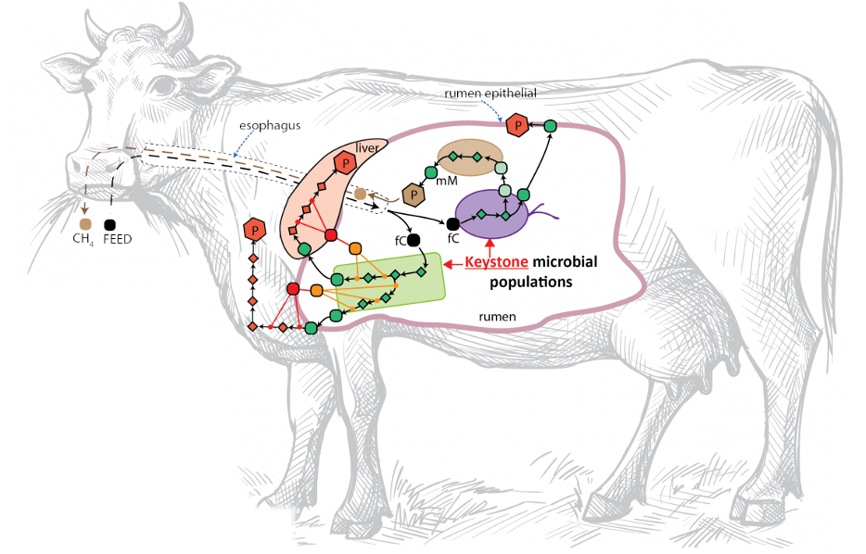
The holobiont
Notes:
(The holobiont)
The holobiont concept emphasizes analyzing the host and its microbiome as a whole. In this context, “holo-omics” presents quantitative methods that can be used to investigate host-microbiome data and to facilitate predictions on biological interactions.
The cattle hosts a microbiome in its rumen, which is the first of the stomachs that the feed enters when grazing.
There is an axis from the digesta, through the rumen wall, to the liver. In the rumen, plant fibers are degraded by microbes into SCFAs or VFAs and more complex metabolites that are taken up through the epithelium of the rumen wall. The rumen wall is able to directly transport some VFAs directly into the blood. Whereas more complex metabolites like acetate and propionate are transported through the portal vein to the liver where they are processed before they become available for the host.
-

Slide 4
The holobiont
Notes:
(The holobiont, cont'd)
We hypothesize that this microbiome interacts with its host. There might be several processes where the host -in this case the cattle- directs the microbiome: consisting of bacteria, archaea, ciliates and fungi - and viruses.
-

Slide 5
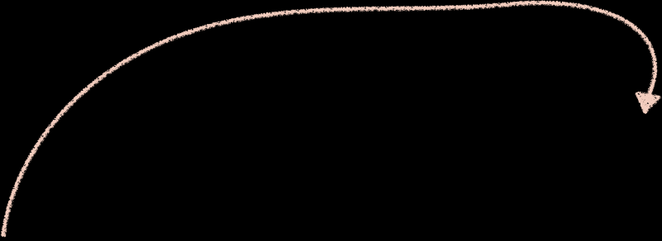

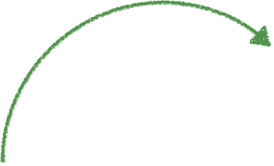
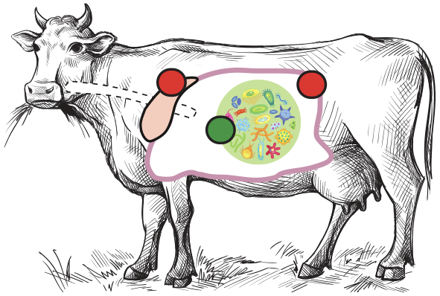
 |  | ←←← Microbiome/Host Sample Source →→→
 |  | Digesta fluid from rumen (microbial soup) | Epithelium of rumen wall (host) | Liver (host)
 | DNA Genomics | illumina for depth (0.5E9 reads) Nanopore for length (480 Gbp ONT-R10)
 | rRNA (16S) | 16S for diversity
 | RNA Transcriptomics | illumina (1.2E9 reads) | illumina (1.2E9 reads) | illumina (1.2E9 reads)
 | Protein Proteomics | LC-MS/MS (targets from corresponding MAGs) | LC-MS/MS (targets from host genome) | LC-MS/MS (targets from host genome)
 | Volatile Fatty Acid (VFA) Metabolomics | Targeted VFA analysis (6 VFA targets)
 | Untargeted Non-Protein Metabolomics | LC-MS/MS (62 targets) | LC-MS/MS (62 targets) | LC-MS/MS (62 targets)
 | Key Performance Indices | Methane production (CH4), Dry Matter Intake (DMI), Average daily gain (ADG), Feed Conversion Ratio (FCR)
←←← Molecular Layer → → →
Notes:
(Sampling the complete holobiont)
So this is why our project becomes relevant.
We sampled 71 cattle bulls, two Scottish breeds.
- Abeerdeen Angus Limousine cross
- Luing
We have collected a comprehensible multi-omics dataset to capture a broad view of the holobiont.
Here is an overview of our dataset. You see that we have three sample locations within the holobiont: Digesta of the rumen, Epithelium of the rumen wall and Liver, represented by the three columns in the table.
(DNA)
For DNA we have genomics, both illumina on all samples for precise coverage as well as Oxford Nanopore Technologies long reads on a subset of the samples, using flowcell R10.4 for strain level metagenome assembled genome -MAG- recovery.
We have 16S ribosomal RNA metabarcoding on the full 71 samples as well, to be able to look into the genus level diversity and relative biomass of the bacteria and archaea.
(RNA and proteomics)
For RNA, proteomics and untargeted metabolomics we have analyzed all three sample locations.
(VFA)
Regarding VFAs we have measurements for 6 common VFA targets in the digesta, to track the breakdown of plant fibre polymers.
And for phenotypic information - or key performance indecees, we have methane production using a respiration chamber method where we saw 30% variation between bulls. We also have dry matter intake, average daily gain and feed conversion ratio.
-

Slide 6
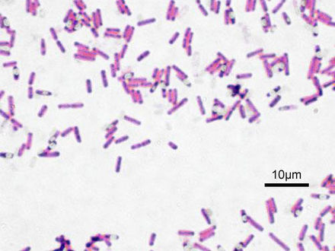
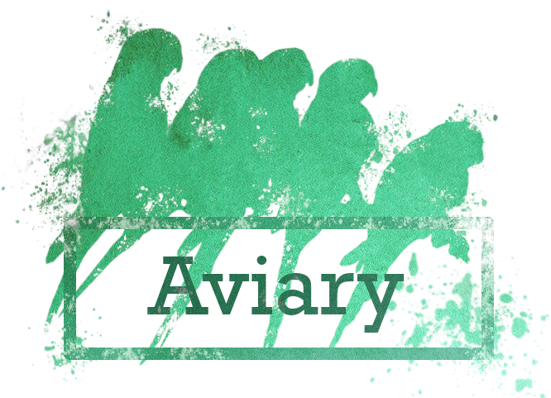
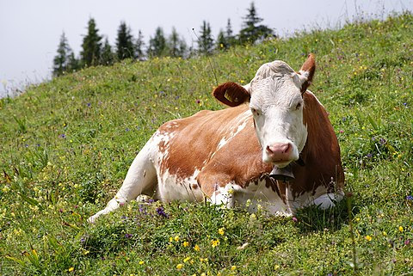

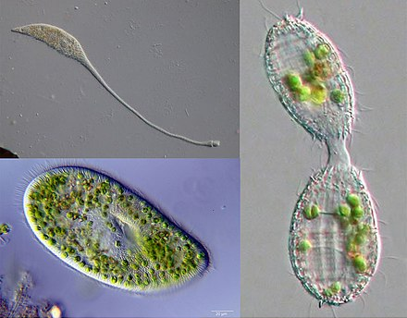




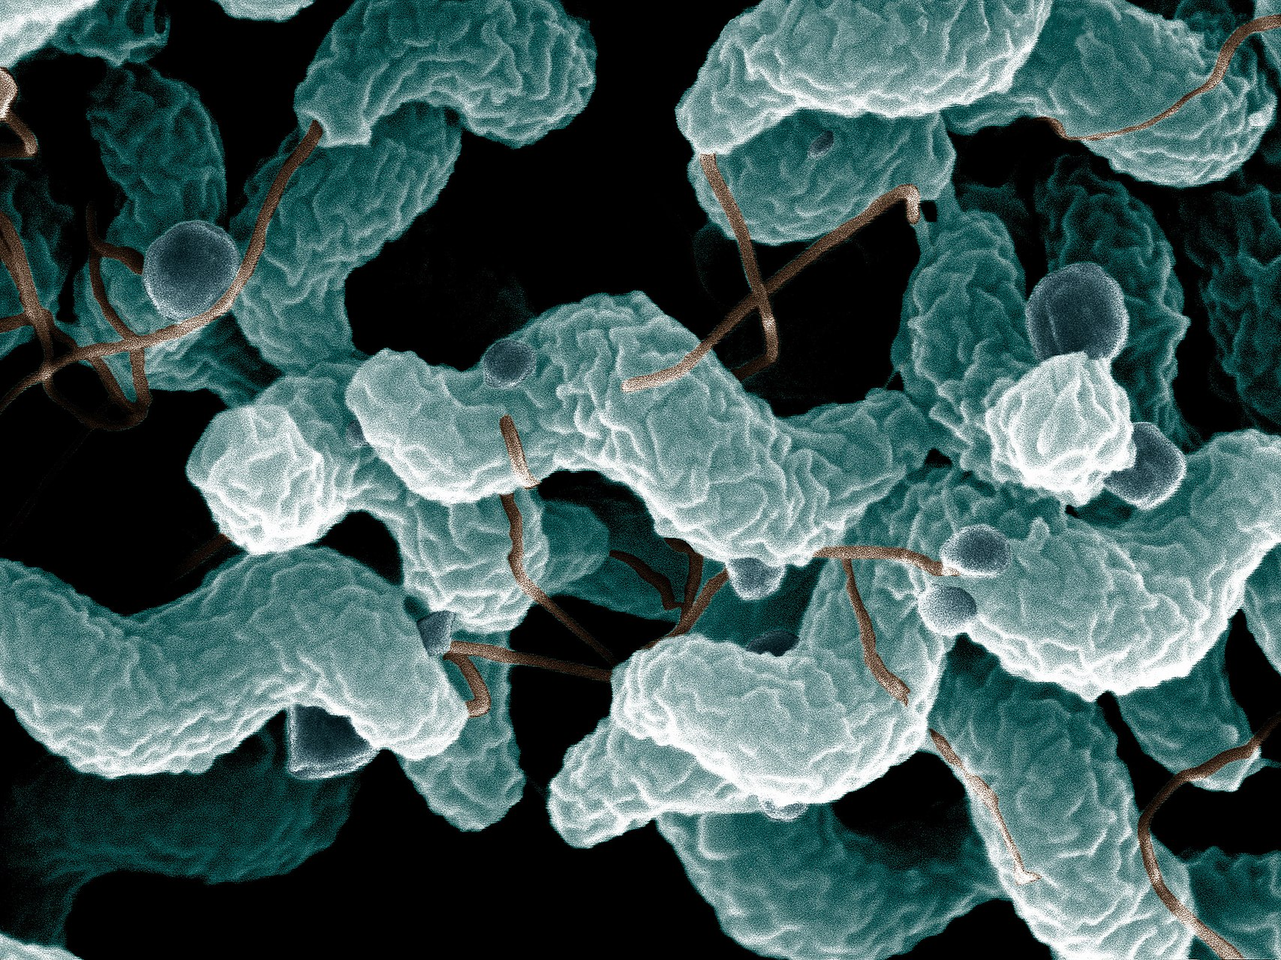
Ruminal microbial database (no. genomes)
MAGs. Archaeal and Bacterial (700)
The Cattle host Bos taurus (1) PRJNA391427
Ciliate genome of Entodinium caudatum (1) Park et al., Genomics 2021
Ciliate Litostomatea genomes from SAGs (52) Li et al., ISME 2022
Neocallimastigomycetes, anaerobic fungi (9) JGI mycocosm
Campylobacter (14) Strachan et al., Nat. Microbiology 2023
Arturo Vera Ponce
de Leon, MEMO
Andy Leu, CMR
All pictures CC-BY-SA from common wikipedia articles.
Notes:
(Database)
As a basis for the central dogma of molecular biology that underpins the multi-omics stack, we had to create a database consisting of all of the genomes, and translated genes, of all of the known species in the central environment - The rumen.
Our home made MAGs using DNASense's pipeline. We've further revised these with Rhys Newell's Aviary pipeline thanks to Andy Leu from Centre for Microbiome Research in QUT.
Just a standard refseq host genome for Bos taurus, cattle.
One of the first high quality genomes from the Ciliate Entodinium caudatum.
52 Ciliate SAG genomes from 20 Litostomatea species.
All publicly available Neocallimastigomycetes class anaerobe fungi known to inhabit the rumens of cattle, hosted by JGI.
14 Campylobacter strains, known to possibly -but not so much in our case- inhabit the rumen wall.
All in all, 777 genomes of various sizes representing a large part of the tree of life.
Creating this database was a team effort and I want to give a shoutout to our bioinformatician and engineer Arturo Vera Ponce de Leon.
-

Slide 7
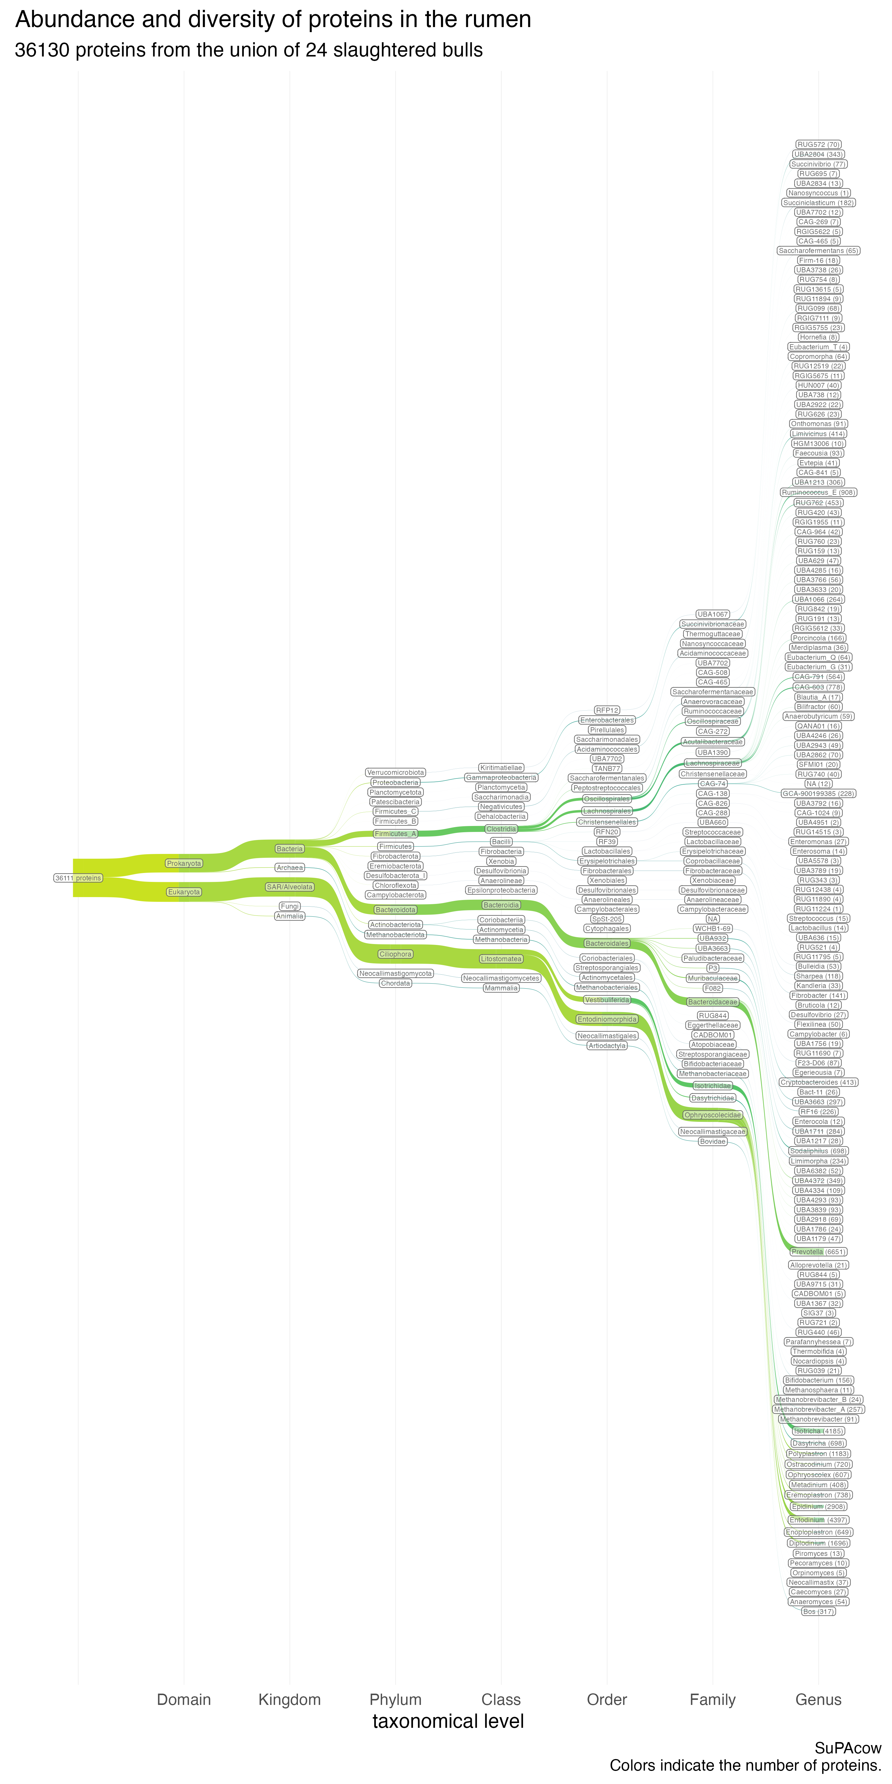
24 bulls, rumen digesta proteomics
Notes:
(Proteomics of the digesta)
So - jumping into an example of the data that we have.
This is a phylogenetic overview of the proteomics of the digesta. The height of the tree branches show counts of unique protein groups arranged by clade. Here I'm only showing up till family level for brevity.
-

Slide 8
24 bulls, rumen digesta proteomics
Notes:
(Proteomics of the digesta, cont'd)
We see a very high protein count from gtdb-phylums Firmicutes_A and Bacteroidota of Bacteria, as well as Ciliophora, or Ciliates.
The point is that the Ciliates play a large role in the present protein biomass in the digesta. This is in line with previous proteomic studies we've done on the rumen, in our group.
Half prokaryotic, half eukaryotic.
<stress which ciliate species have very high biomass?>
-

Slide 9
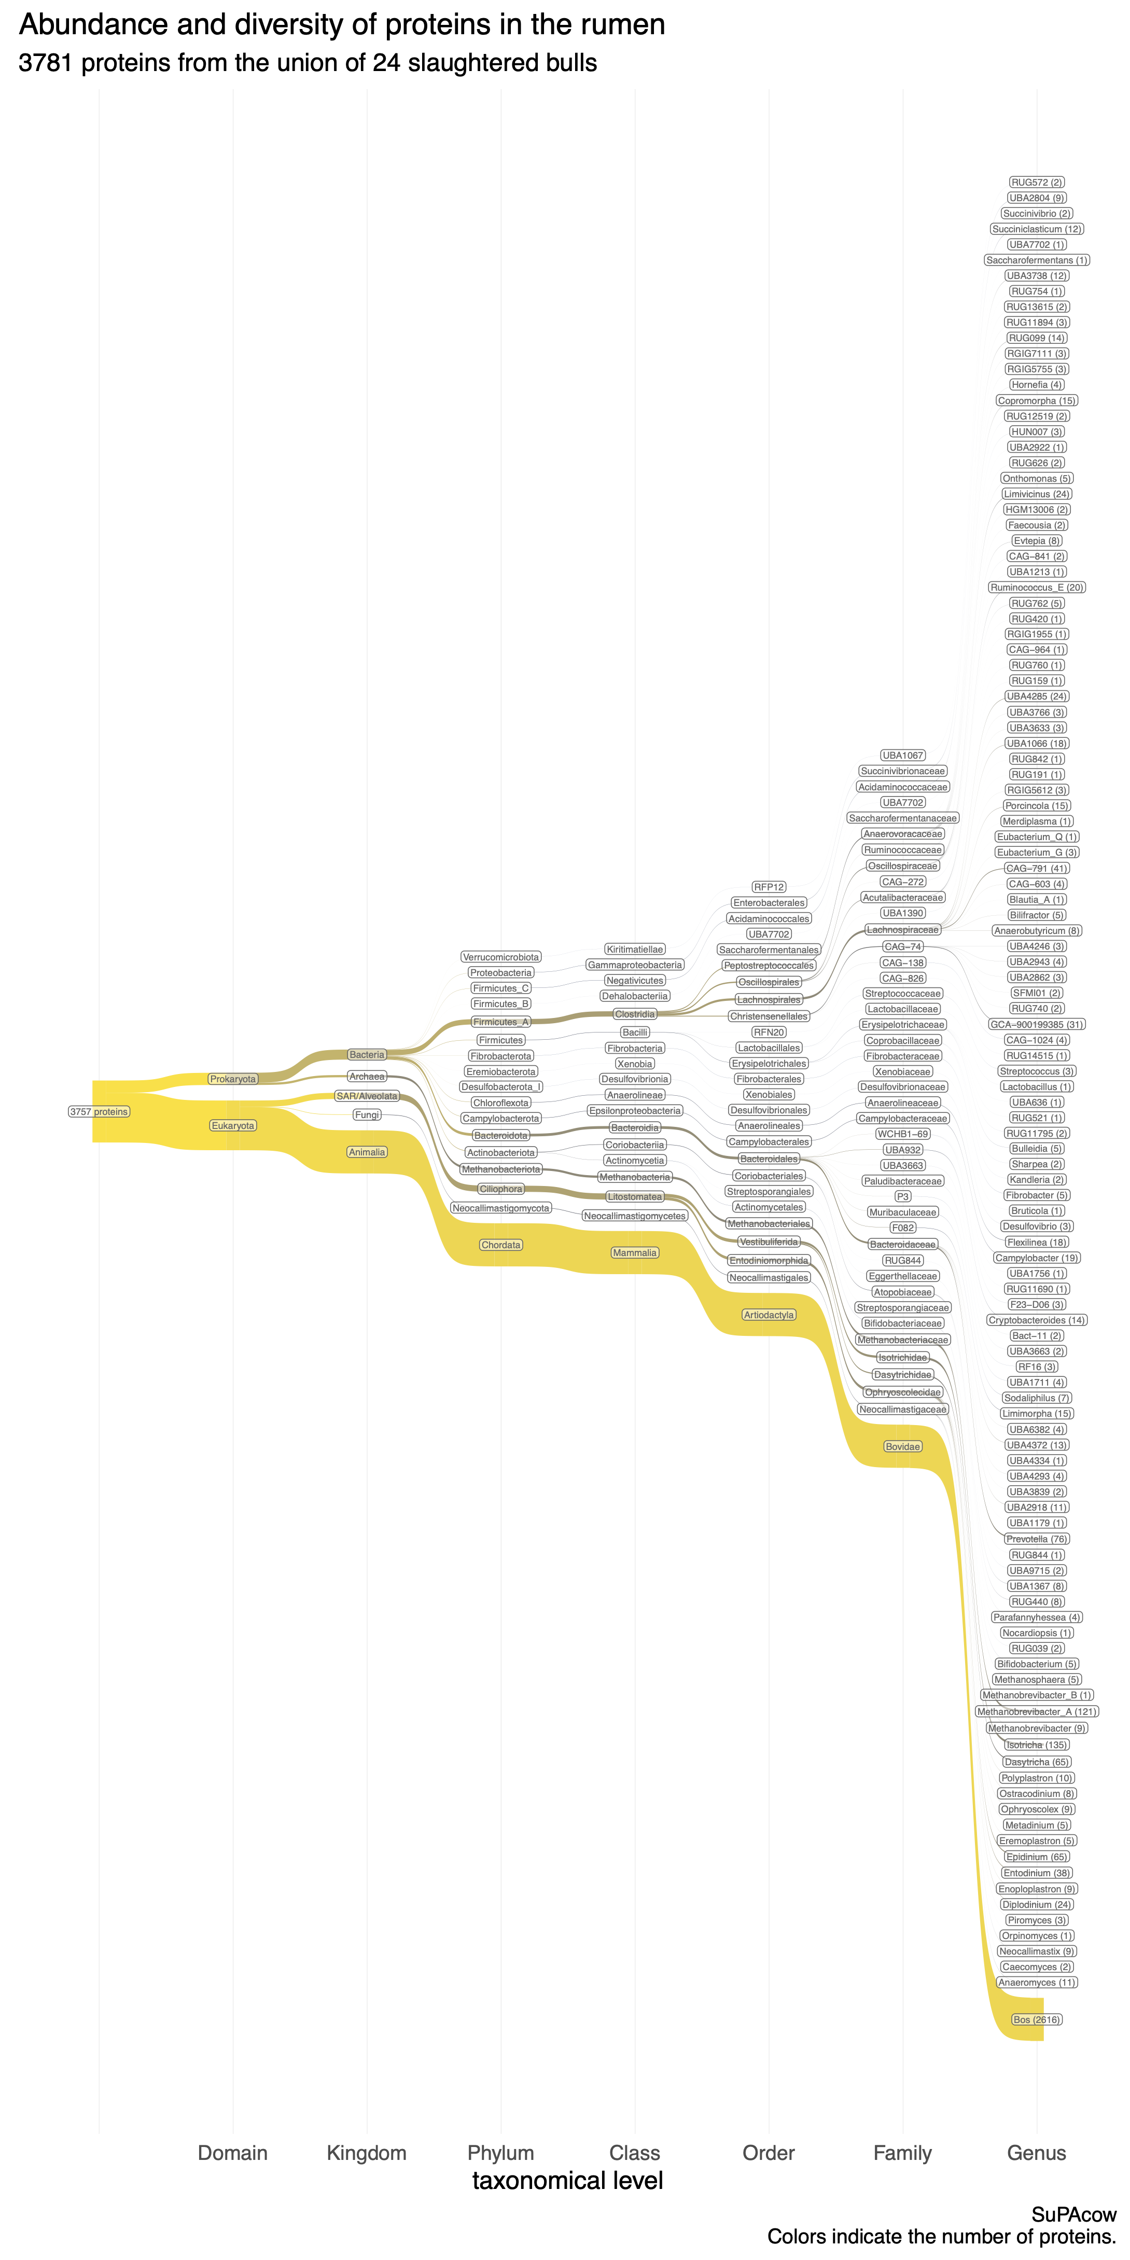
24 bulls, rumen wall proteomics
Notes:
(Proteomics of the Rumen Wall Epithelium)
Same analysis, but for the wall instead of digesta.
We did not wash the wall tissue before extracting proteins for proteomics. Thus here you'll see correlations with what we generally see in the digesta.
-

Slide 10
Notes:
(blank, 2 sec. pause-transition)

Slide 11
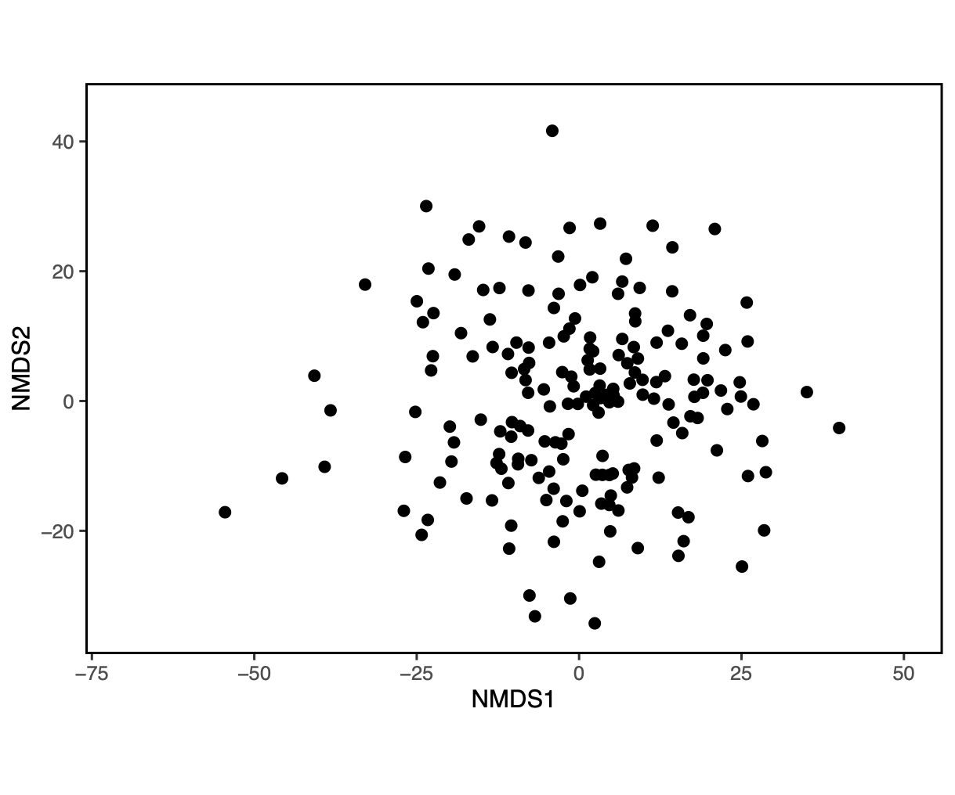
71 Bulls, digesta 16S rRNA sequencing
Notes:
(split raw data, 16S)
So, I want to show you something.
For 16S ribosomal RNA sequencing we had 71 samples. So these are 71 dots. One for each bull.
When looking at the 16S profile of our samples, through the lens of Non-metric Multidimensional Scaling - NMDS, a split appears.
-

Slide 12
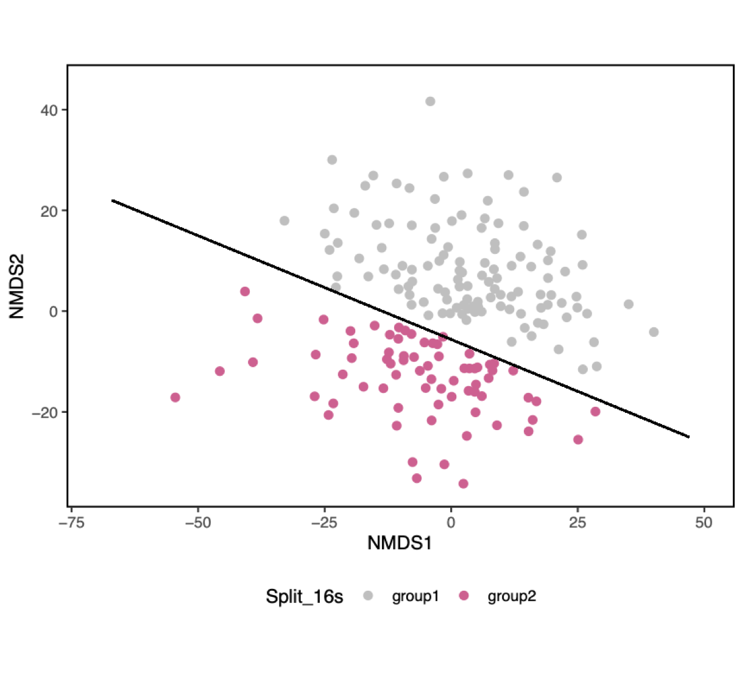
71 Bulls, digesta 16S rRNA sequencing
Notes:
When we saw this we freaked out so we went in to double check that we hadn't somehow biased our samples.
-

Slide 13
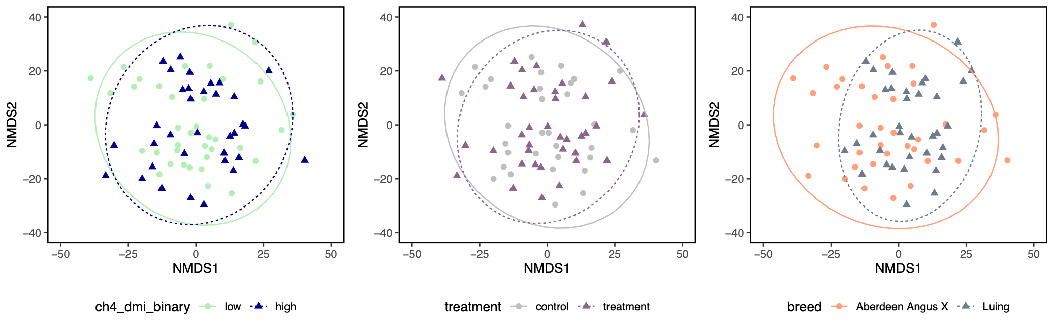
71 Bulls, digesta 16S rRNA sequencing
Notes:
We started looking into obvious effects.
Methane on the left - evenly spread on both sides.
Breed on the right- evenly spread as well.
We didn't want to believe that this was a biological effect. Because there are so many reasons that it could be confounded by something else. Or even just be, a batch effect.
-

Slide 14
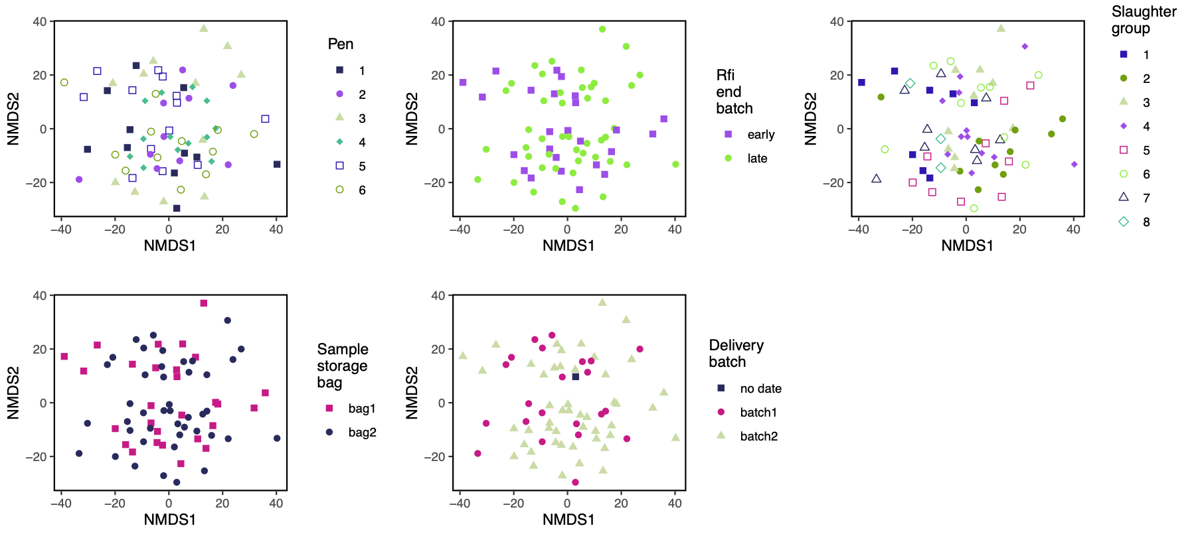
71 Bulls, digesta 16S rRNA sequencing
Notes:
We had a lot of batch variables. Which I'm showing the data for here.
Pen - how the bulls were housed.
Residual Feed Intake - how much they ate.
The slaughter group - in which batch they were slaughtered.
Even in which bag the samples were stored, in our freezer.
And how they were delivered.
No explanation of our split.
Hmm?
-

Slide 15
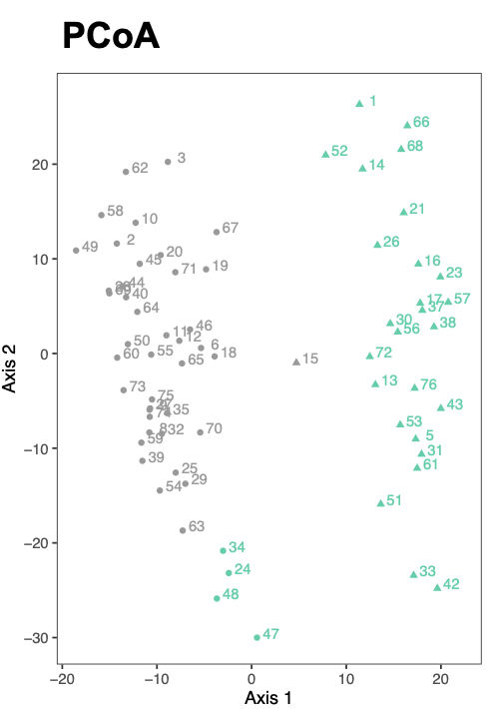
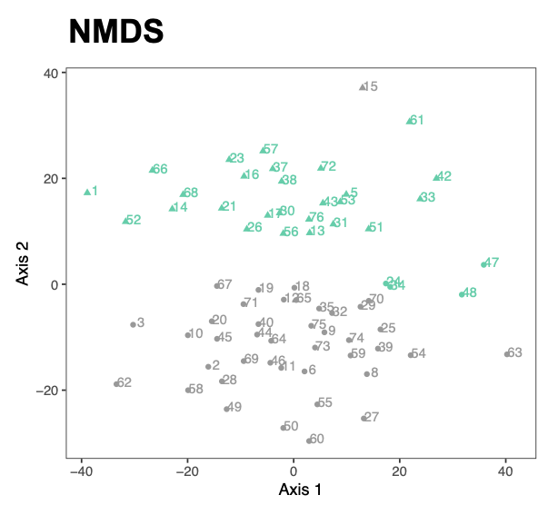
71 Bulls, digesta 16S rRNA sequencing
Notes:
We've been thinking a bit about how we define this split.
What you see in these plots, is something that doesn't totally overlap with the eyeballed 16S split. This is made using hierarchical clustering on robust Aitchison distances. It takes into account the variation of the data that lies beyond what you see here in the first two axes of ordination.
Whether to use one or the other definition of the split is something that we're still figuring out, but for now, well go with this definition.
Principal coordinates analysis shows a good separation, NMDS is possibly clearer.
-

Slide 16
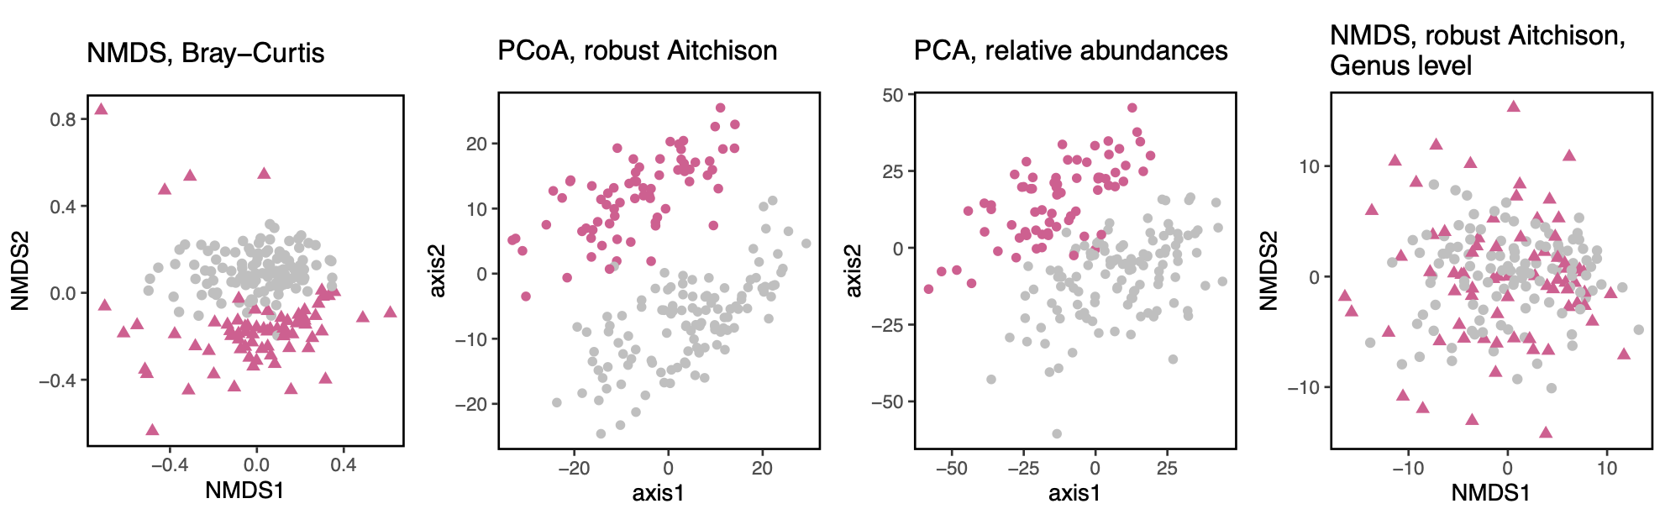
71 Bulls, digesta 16S rRNA sequencing
Notes:
We also tried using other methods.
Just to show that it comes out in many different ways.
NMDS with Bray-Curtis.
Principal coordinates analysis on robust Aitchison.
and PCA on relative abundances.
The split seems quite clear either way. - Great.
-

Slide 17
71 Bulls, digesta 16S rRNA sequencing
Notes:
Critically, we also tried summarizing the abundances on the genus level, and then redoing the "best" method - NMDS on robust Aitchison distances. This shows quite clearly that the split must be driven by species and strain differences above the genus clade.
A possible biological factor.
-

Slide 18
71 Bulls, digesta 16S rRNA sequencing
Notes:
So far, so good.
The clusters can be defined computationally, and seen with many different embedding techniques.
-

Slide 19
Notes:
<Blank 1. sec pause for pacing.>

Slide 20
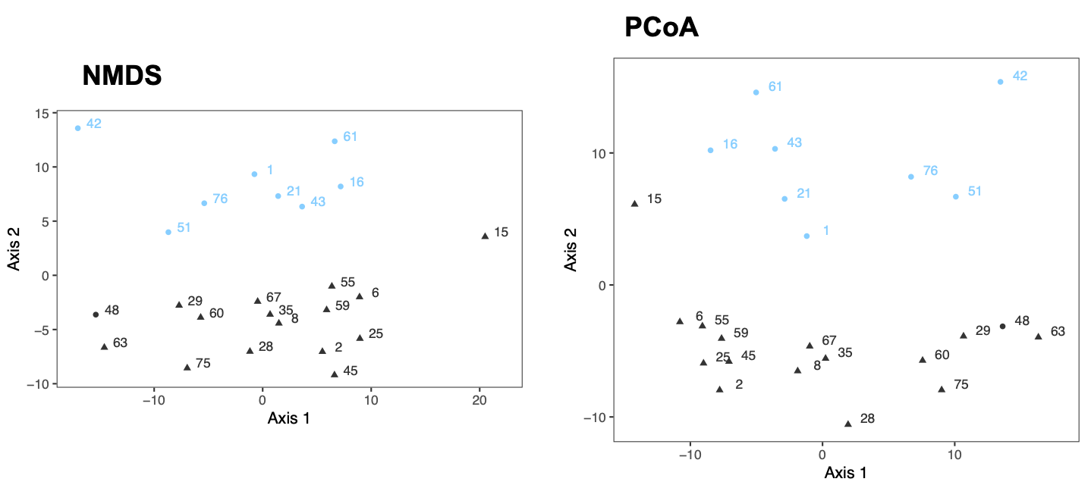
24 Bulls, digesta MAG abundances
Notes:
What I showed up till now was 16S. What about our MAGs of the microbes?
We used the same workflow, but with MAG abundances from CoverM.
Remember, what we're looking at here, is an embedding of the bulls, based on the relative abundances of the Bacterial and Archaeal genomes alone. These are 700 MAGs in the 24 bulls that were deeply sequenced.
Guess what - We still see the split clearly.
-

Slide 21
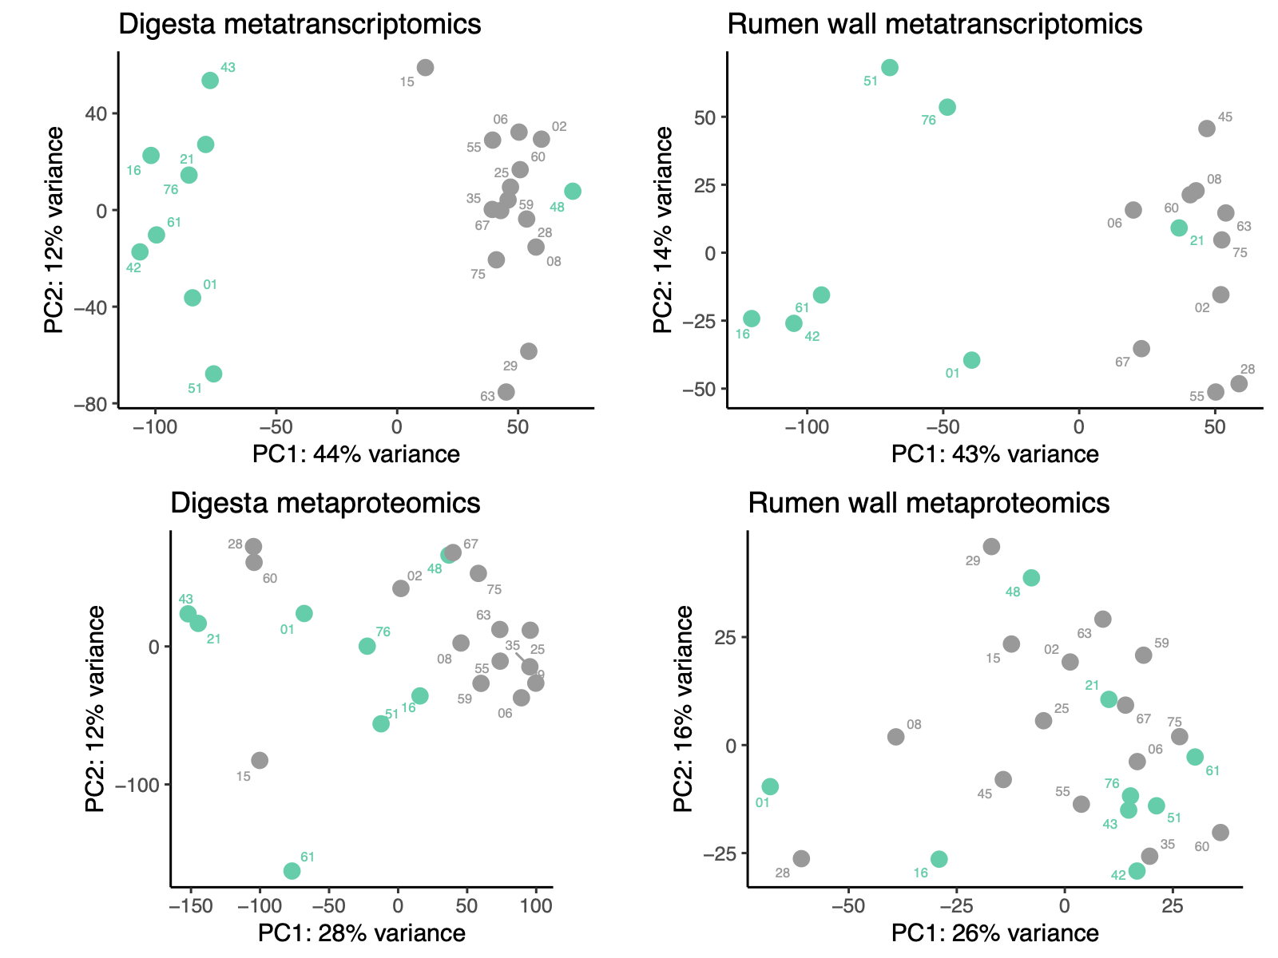
24 Bulls, multi-omics
Notes:
And stepping further into our multi-omics dataset.
Digesta metatranscriptomics, rumen wall epithelium metatranscriptomics, digesta metaproteomics and rumen wall metaproteomics.
We still see strong signs of the split.
-

Slide 22
24 Bulls, proteomics
Notes:
The digesta metaproteomics, on the bottom, doesn't look to be affected too much by the split though.
-

Slide 23
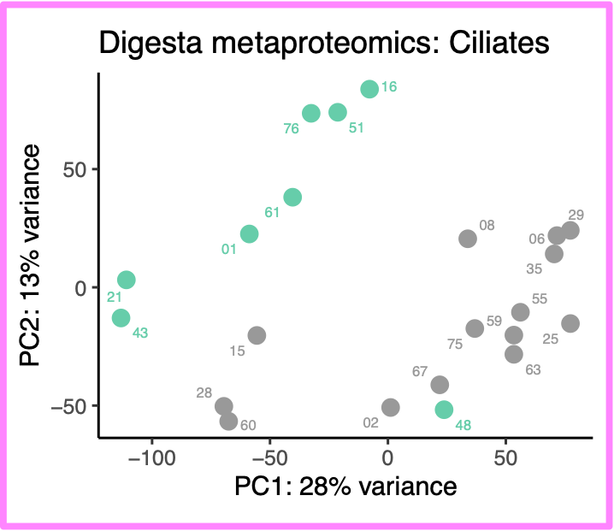

24 Bulls, proteomics
Notes:
But if we focus on the ciliates alone, we get a pretty strong split, more or less identical to the metatranscriptomics.
Transcriptomics and proteomics are such different methods. Where proteomics has redundancy issues, transcriptomics is more specific. So the fact that we're seeing the same split across these different methods, is an indication that something biological might be going on.
-

Slide 24
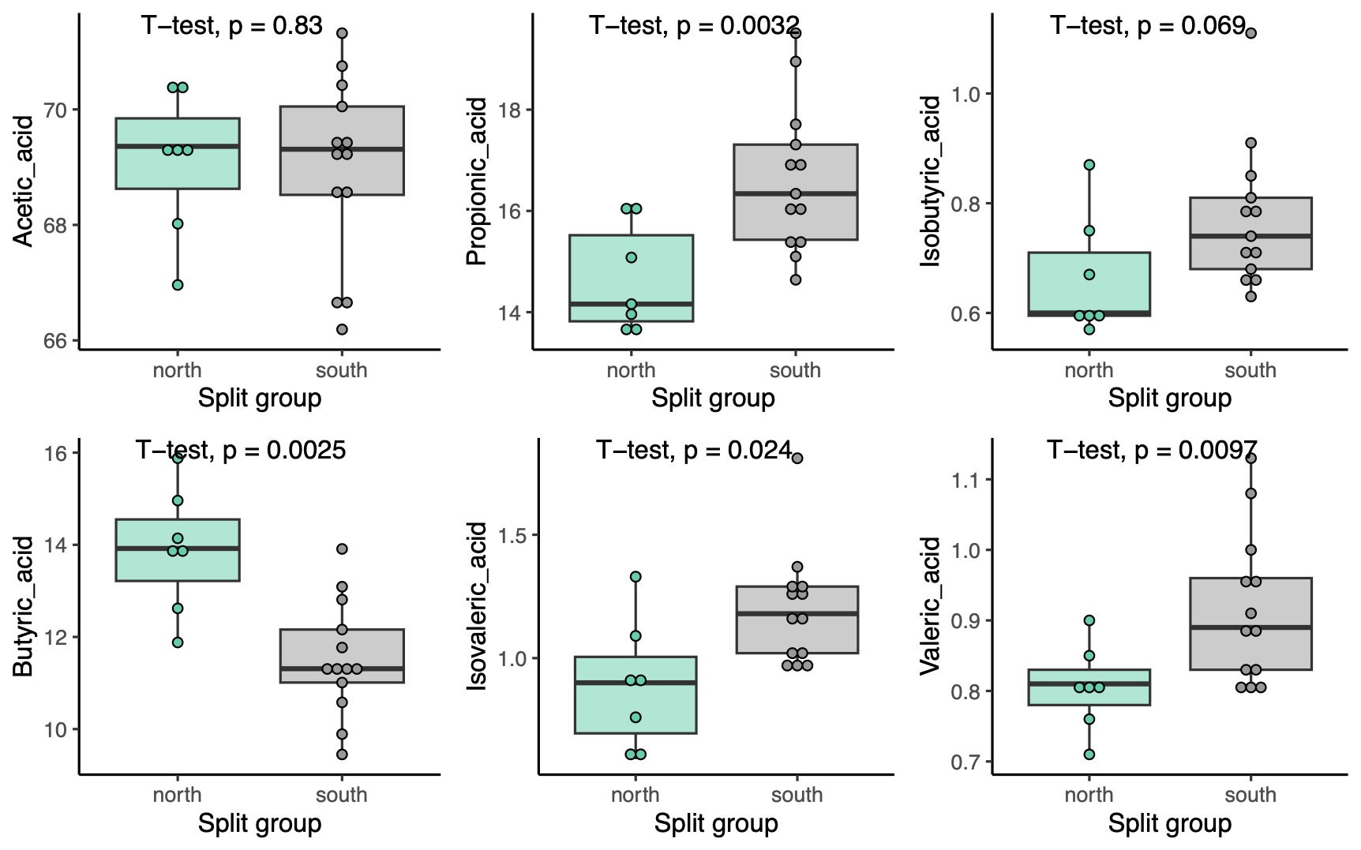
24 Bulls, rumen digesta, targeted Volatile Fatty Acid (VFA) metabolomics
group2
group1
group2
group1
group2
group1
group2
group1
group2
group1
group2
group1
Notes:
(VFA contrasted by The Split)
We also had 6 VFA targets as part of our metabolomics.
We see propionic acid, butyric acid, isovaleric acid and valeric acid being significantly different between these split groups in the digesta of the bulls.
Specifically butyric and propionic acids have a very large difference.
VFAs are very important in the energy transfer from feed to host through the microbiome, so this is another hint, that something biological is lurking in The Split.
-

Slide 25
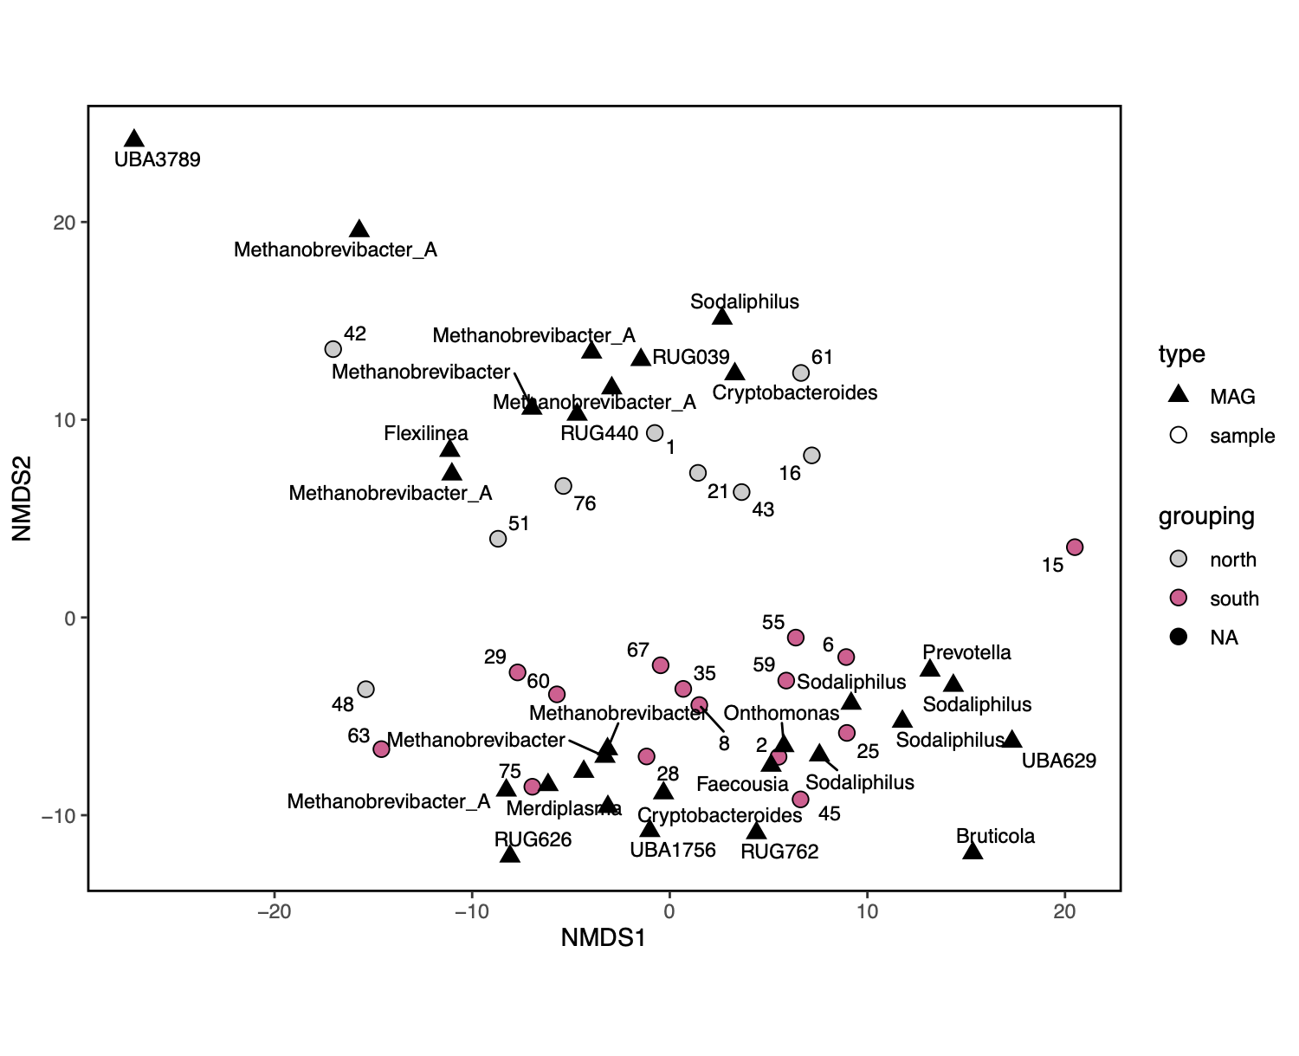
MAG
sample
group1
group2
NA
Notes:
So we know that this is not a batch or technical effect. So what is it then?
This is a MAG abundance NMDS showing samples, which are the bulls. On top of that, we're showing the 30 most influential MAGs defined with distance-based redundancy analysis.
What is interesting is that we see that the influential MAGs driving the split seem to often represent different strains of the same genus.
Group1 on the upper side:
- Some Methanobrevibacter_A
- Bifidobacteriaceae RUG 39
Group2 on the lower side:
- Lachnospiraceae RUG 762
- Prevotella
- Faecousia
Genuses present on both sides are:
- Sodaliphilus
- Cryptobacteroides
- and Methanobrevibacter
-

Slide 26

Notes:
The fact that same genuses are present on both sides recapitulates that we see no split when averaging 16S abundances on a genus level. - That the strain differences within species are driving the split.
-

Slide 27
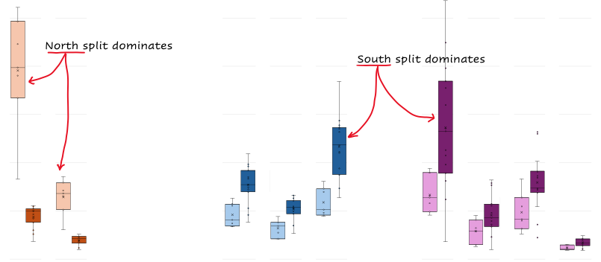
24 bulls, digesta rumen proteomics,
Protein biomass per genus
group1 = dark shading
group2 = light shading
group2 side dominates
group1 side dominates
Genus Epidinium
Genus Entodinium
Genus Isotricha
Notes:
<consider using phils more annotated version with the nmds and arrows>
We think, maybe the Ciliates are driving this.
We saw in the digesta metaproteomics that the ciliates follow recapitulate The Split. Here my supervisor, Phil Pope, has counted the proteomic intensities for three Ciliate genuses: Epidinium, Entodinium and Isotricha.
Epidinium has the largest biomass of all ciliates. The protein biomass is much higher than for others. These ciliate genomes are booming with fibre degrading cazymes. They play an important role fermentation and butyrate production.
(for questions: One reason why ciliates can sustain such a large biomass isbecause they predate on prokaryotes)
-

Slide 28
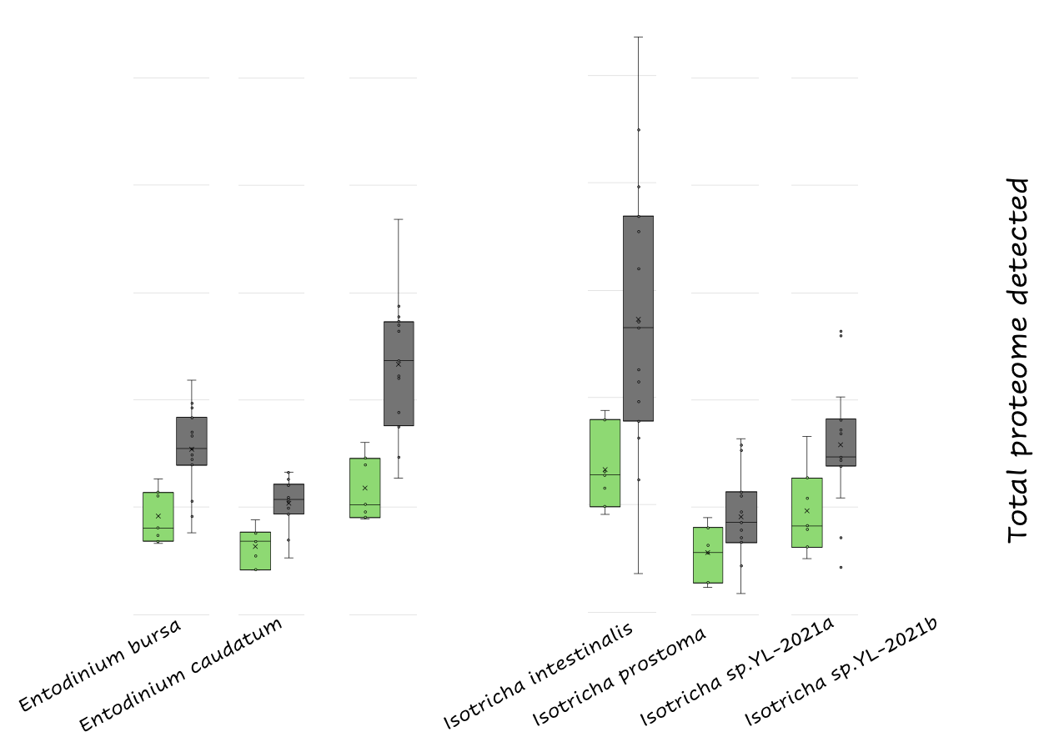
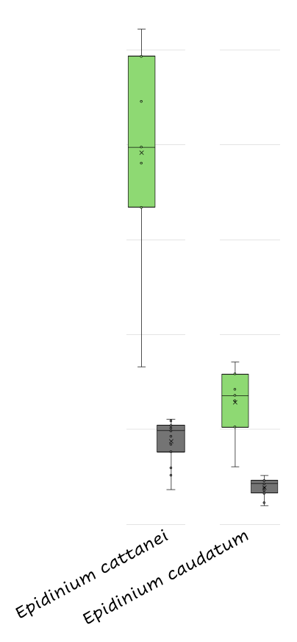
24 bulls, digesta rumen proteomics,
group1 = grey shading
group2 = green shading
Protein biomass per species
Notes:
We think, maybe the Ciliates are taking part in driving this as well.
We saw in the digesta metaproteomics that the ciliates follow The Split. Here my supervisor, Phil Pope, has counted the proteomic intensities for three Ciliate genuses: Epidinium, Entodinium and Isotricha, contrasted by The Split.
Epidinium, on the left side, has the largest biomass of all ciliates, and dominates group2.
Whereas Entodinium and Isotricha -on the right side- dominate the group1.
These ciliate genomes are booming with fibre degrading cazymes. They play an important role in fermentation and butyrate production.
-

Slide 29
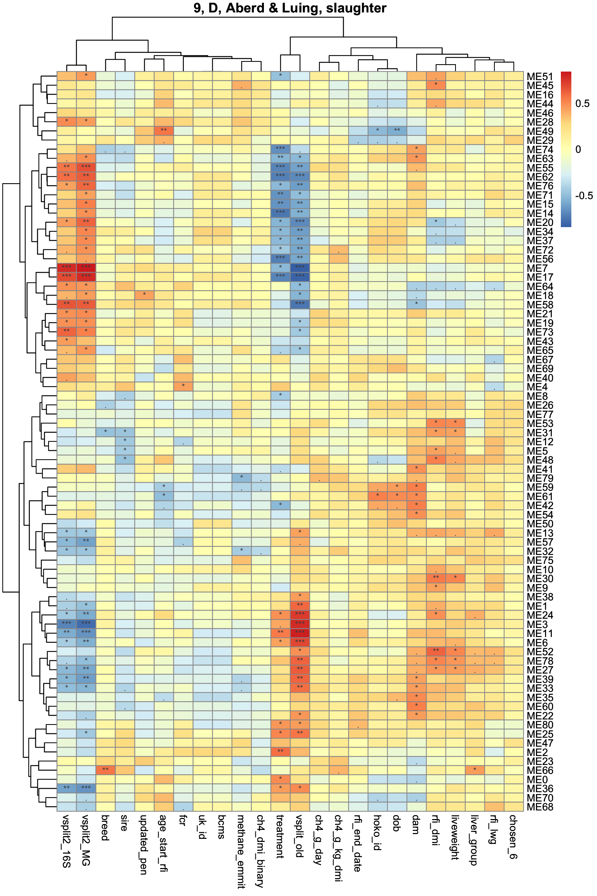
24 bulls, digesta rumen proteomics,
WGCNA protein eigengenes, correlated to The Split
Protein Eigengene / Split
Correlation coefficient
Notes:
(Quick intro to holo-omic modeling using WGCNA)
Okay, so let's try to go a bit more in depth of the species driving this Split, using an alternative methodology.
This overall problem that we're faced with is reminiscent of the needle-in-the-haystack problem.
We have an absolute haystack of information, and we need to find the needle -- the biological signal that drives this split.
So we used WGCNA -weighted gene co-expression network analysis- which is a framework that does hierarchical clustering to group the proteins into clusters. For each of these clusters, principal component analysis, roughly, is applied to define so called eigen proteins, which are idealized proteins that capture the main variation within each of these clusters.
These clusters -or eigen proteins hereof- we can correlate to our KPIs and metadata. What you see here is all digesta eigen proteins correlated to the split variable.
-

Slide 30
24 bulls, digesta rumen proteomics,
WGCNA protein eigengenes, correlated to The Split
Protein Eigengene / Split
Correlation coefficient
Protein eigengenes positively
correlated ..
.. & negatively correlated to the split.
Notes:
If we then take the top 5% most extremely correlated proteins in these modules, and summarize which species they come from, we get something that looks like this.
-

Slide 31
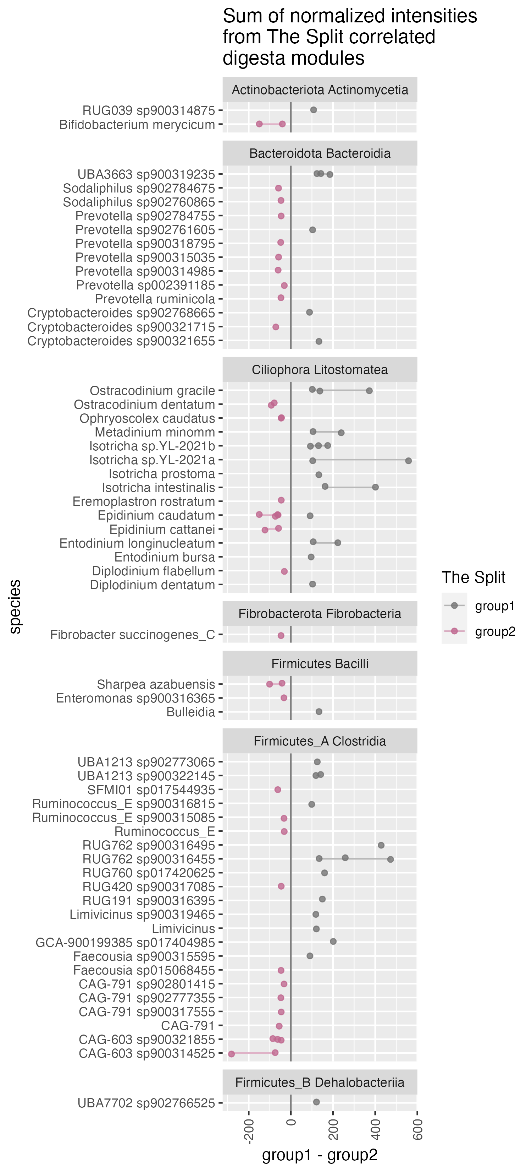
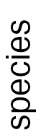
24 bulls, digesta rumen proteomics,
Sum of normalized intensities from The Split correlated digesta WGCNA modules
Notes:
The clades in the panes are phylum and class, and the names next to the dots are genus and species.
What we see is that there is a great overlap of these results with the metagenomic split results. Let me annotate which ones are overlapping.

Slide 32
24 bulls, digesta rumen proteomics,
Sum of normalized intensities from The Split correlated digesta WGCNA modules
Notes:
So these are the Bacteria that overlap with the distance based redundancy analysis of the metagenomes.

Slide 33
24 bulls, digesta rumen proteomics,
Sum of normalized intensities from The Split correlated digesta WGCNA modules
Notes:
And additionally, these are the Ciliates that I've already mentioned. Isotricha and Entodinium in group1, and Epidinium in group2. Which is exactly what we've already seen. Here it looks like specifically Isotricha plays a large role.
Again. This is a completely different approach, but we find many of the same species as with the NMDS distance based redundancy analysis, at least for the bacteria.
So from this point, the natural thing to do would be to go into an analysis of the functions of these proteins. Looking into pathway enrichment analysis, and possibly genome scale metabolic modeling.
Which direction the causality is driven: the split driving the species or vice versa is not easy to discern, but the key is to look further into the function of the features -- To see what specific biological processes are affected.
We also need to explore this in other datasets. We think we've seen similar splits in other studies, which have not yet been explained, possibly due to lack of high resolution data.
-

Slide 34
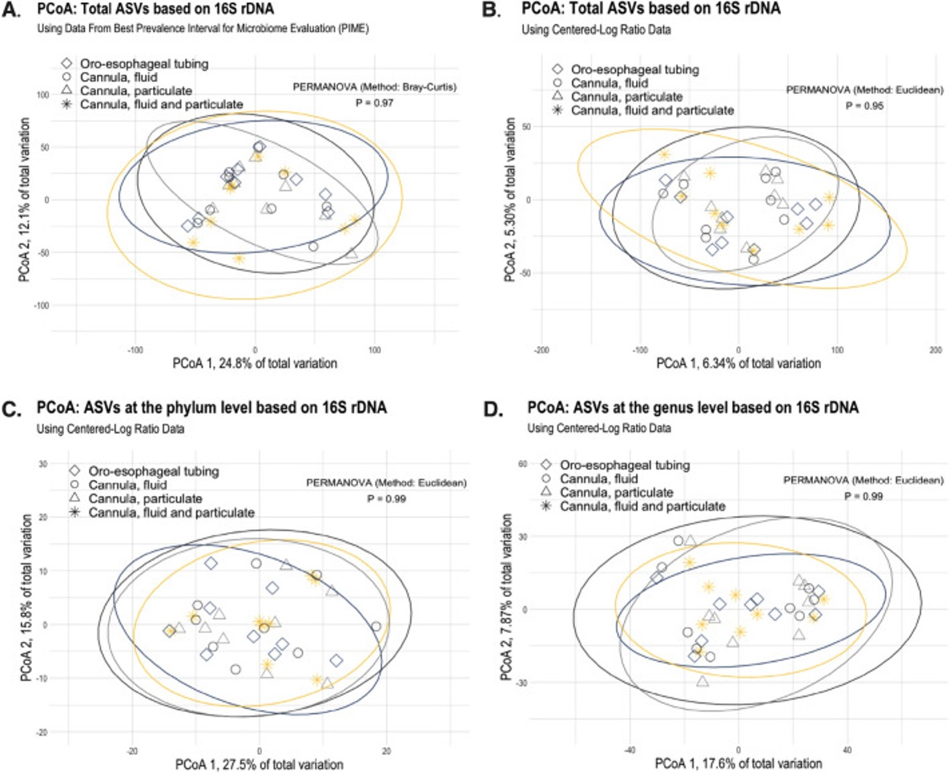
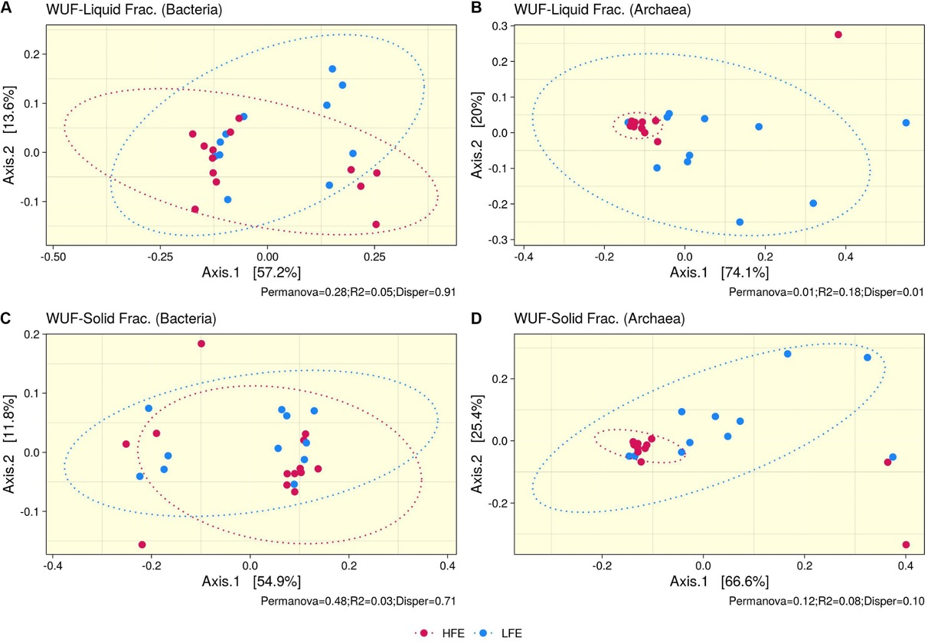
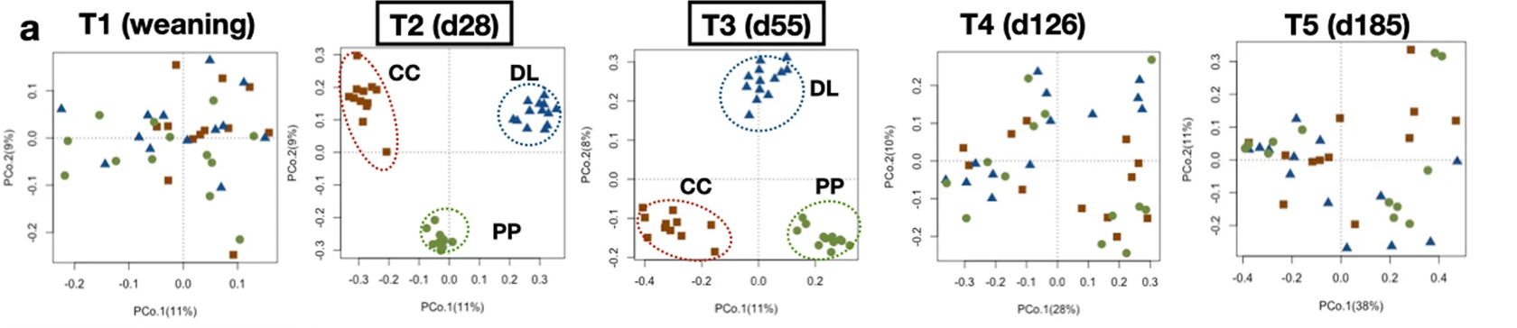
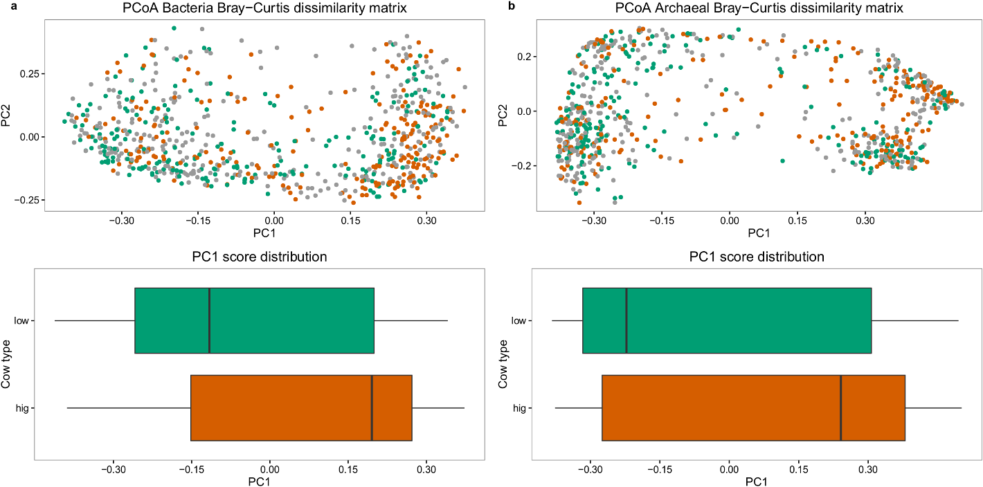
Notes:
(Slide showing asv split in other projects)
This unique observation is not specific for our dataset alone. We see other dataset having uncharacterized splits.
Protists might be the driver of such split.
(Keystone species. What is driving what. We also have a lot of redundancy.)
Bottlenecks: Database genome quality.
Other people have seen similar splits ...
<Published data >
-

Slide 35
Take-home
Two clusters without technical/batch explanation
Good reason to believe that this is biological:
  separation specifically above the genus level,
  pervasiveness across omic layers,
  and its link to high biomass ciliates which are known to affect VFA metabolism.
Notes:
(Take-home)
So this is the take home.
Two clusters, and good reason to believe that it is biological.

Slide 36

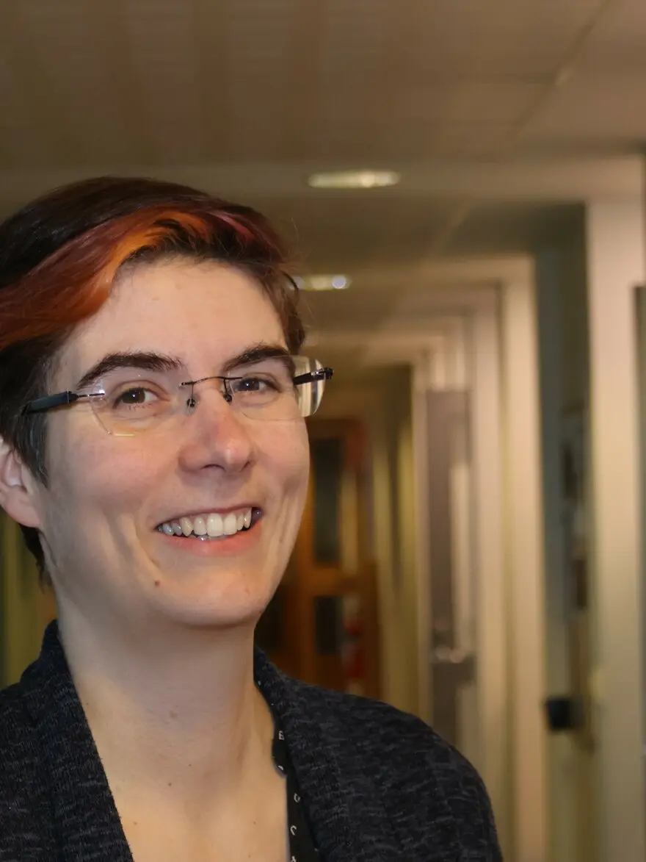
Discussion
& questions?
Velma Tea Essi Aho
CGIF presentation by
Carl Mathias Kobel, PhD student
Please contact me at:
carl.mathias.kobel@nmbu.no
Or check out some of my other work at
github.com/cmkobel
Notes:
I want to give a special shout out to my colleague, postdoc Velma Tea Essi Aho who did a lot of work to characterize the variation and to test for possible batch and technical effects. She will present this more in depth at ISME.
Now I will open the discussion and questions part of my presentation. I must say, these are preliminary data, and we're still trying to figure things out. But let me know what your ideas and questions are.
---
standard answer #1: This is preliminary data and we're still working on this. We also still have more questions than answers.
#2: A reason why ciliates can sustain such a large biomass isbecause they predate on prokaryotes.
-

