Slide 1
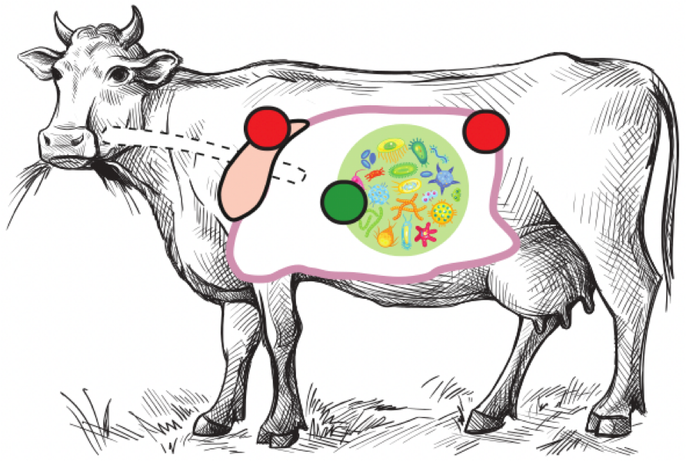




Rumen Holo-omics
& The Microbiome Split
Carl Mathias Kobel, PhD student
The Microbial Ecology and Meta-Omics group (MEMO)
Norwegian University of Life Sciences (NMBU)
In collaboration with Centre for Microbiome Research, QUT, Woolloongabba, Australia
Hyperlink: https://cmkobel.github.io/
Notes:
(Start, target 19 slides excluding blanks)
Hello. Thanks for giving me the opportunity to talk here today.
I'm Carl, I'm a PhD fellow from the MEMO group at NMBU in Norway.
Today I will present a state-of-the-art multi-omic holo-omic high resolution rumen based project that we have undertaken and are currently analysing the data for.
-

Slide 2
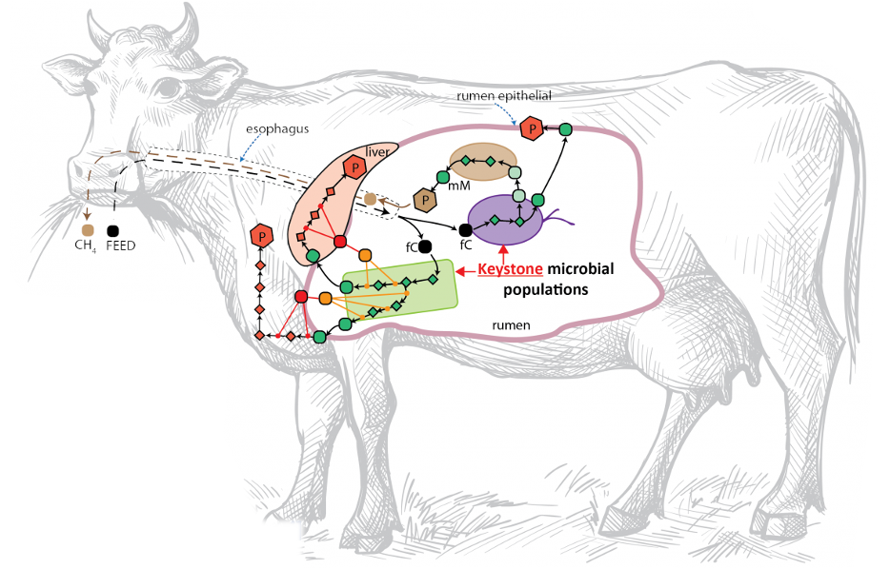
The holobiont
Notes:
(The holobiont)
The cattle is a great example of a holobiont.
The cattle hosts a microbiome in its rumen, which is the first of the stomachs that the feed enters when grazing.
There is an axis from the digesta through the rumen wall to the liver. In the rumen, plant fibers are degraded by microbes into SCFAs or VFAs and more complex metabolites that are taken up through the epithelium of the rumen wall.
The rumen wall is able to directly transport some VFAs directly into the blood -- Whereas more complex metabolites like acetate and propionate, are transported through the portal vein to the liver, where they are processed before they become available for the host.
We hypothesize that this microbiome interacts with its host. There might be several processes where the host -in this case the cattle- directs the microbiome: consisting of bacteria, archaea, ciliates and fungi - and viruses.
-

Slide 3
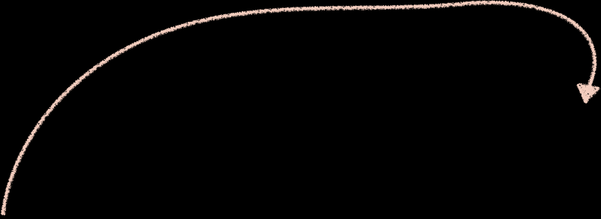
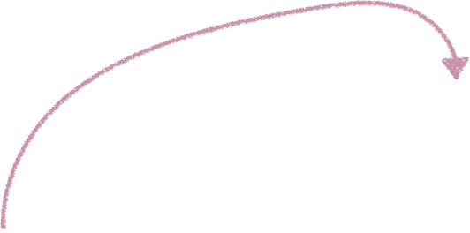
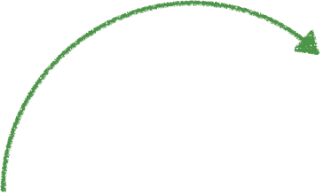
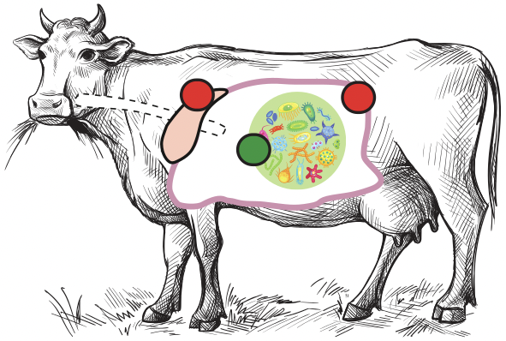
 |  | ←←← Microbiome/Host Sample Source →→→
 |  | Digesta fluid from rumen (microbial soup) | Epithelium of rumen wall (host) | Liver (host)
 | DNA Genomics | illumina for depth (0.5E9 reads) Nanopore for length (480 Gbp ONT-R10)
 | rRNA (16S) | 16S for diversity
 | RNA Transcriptomics | illumina (1.2E9 reads) | illumina (1.2E9 reads) | illumina (1.2E9 reads)
 | Protein Proteomics | LC-MS/MS (targets from corresponding MAGs) | LC-MS/MS (targets from host genome) | LC-MS/MS (targets from host genome)
 | Volatile Fatty Acid (VFA) Metabolomics | Targeted VFA analysis (6 VFA targets)
 | Untargeted Non-Protein Metabolomics | LC-MS/MS (62 targets) | LC-MS/MS (62 targets) | LC-MS/MS (62 targets)
 | Key Performance Indices | Methane production (CH4), Dry Matter Intake (DMI), Average daily gain (ADG), Feed Conversion Ratio (FCR)
←←← Molecular Layer → → →
Notes:
(Sampling the complete holobiont)
So this is why our project becomes relevant.
We sampled 71 cattle bulls. Two breeds, Luing, and Aberdeen Angus Limousin cross.
Three sample locations to capture the holo-omic axis – Three columns in the table.
Comprehensive sequencing of several molecular layers to capture the metabolism and signalling of the biological pathways – several rows in the table.
(DNA)
For DNA we have 16S for overview, illumina for depth and ONT R10.4 for length.
(RNA and proteomics)
For RNA, proteomics and untargeted metabolomics we have analyzed all three sample locations.
(VFA)
Regarding VFAs we have measurements for 6 common targets in the digesta, to track the breakdown of plant fibre polymers.
And for phenotypic information: Among other key performance indecees we have methane production using a respiration chamber method where we saw 30% variation between the bulls.
-

Slide 4
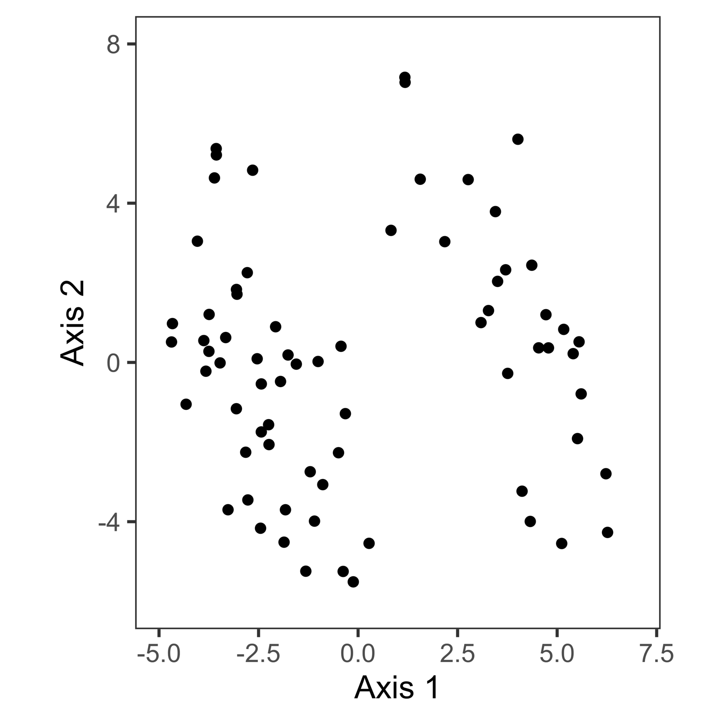
71 Bulls, digesta 16S rRNA sequencing
Timepoint 6, Robust Aitchison distances + PCoA
Notes:
(split raw data, 16S)
So, I want to show you something.
For 16S ribosomal RNA sequencing we had 71 samples. So these are 71 dots. One for each bull.
When looking at the 16S profile of our samples, through the lens of ordination – in this case PCoA – The Split appears.
-

Slide 5
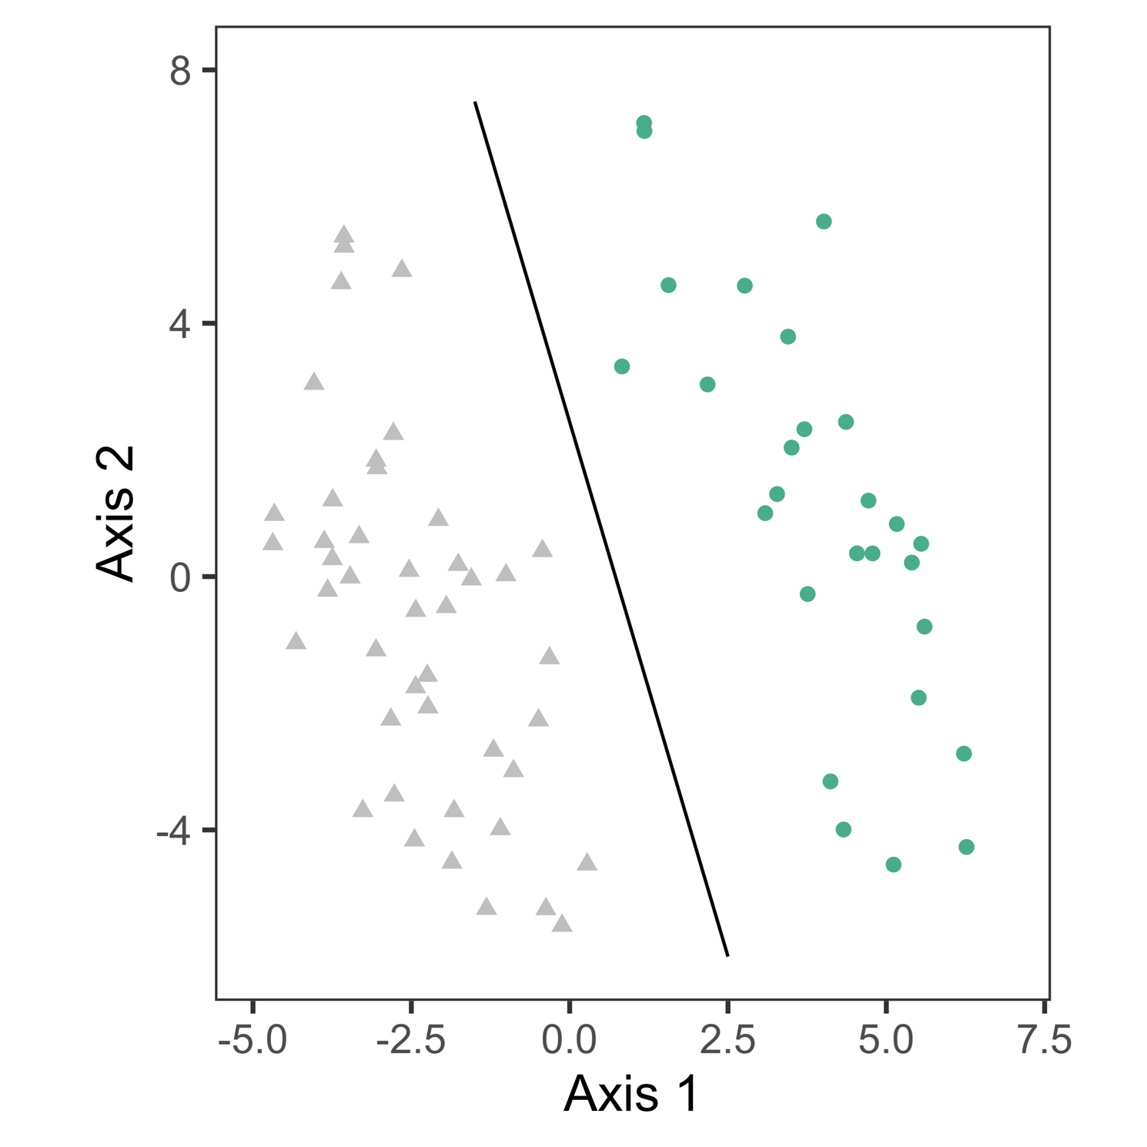
71 Bulls, digesta 16S rRNA sequencing
Timepoint 6, Robust Aitchison distances + PCoA
Notes:
When we saw this we freaked out so we went in to double check that we hadn't somehow biased our samples.
-

Slide 6
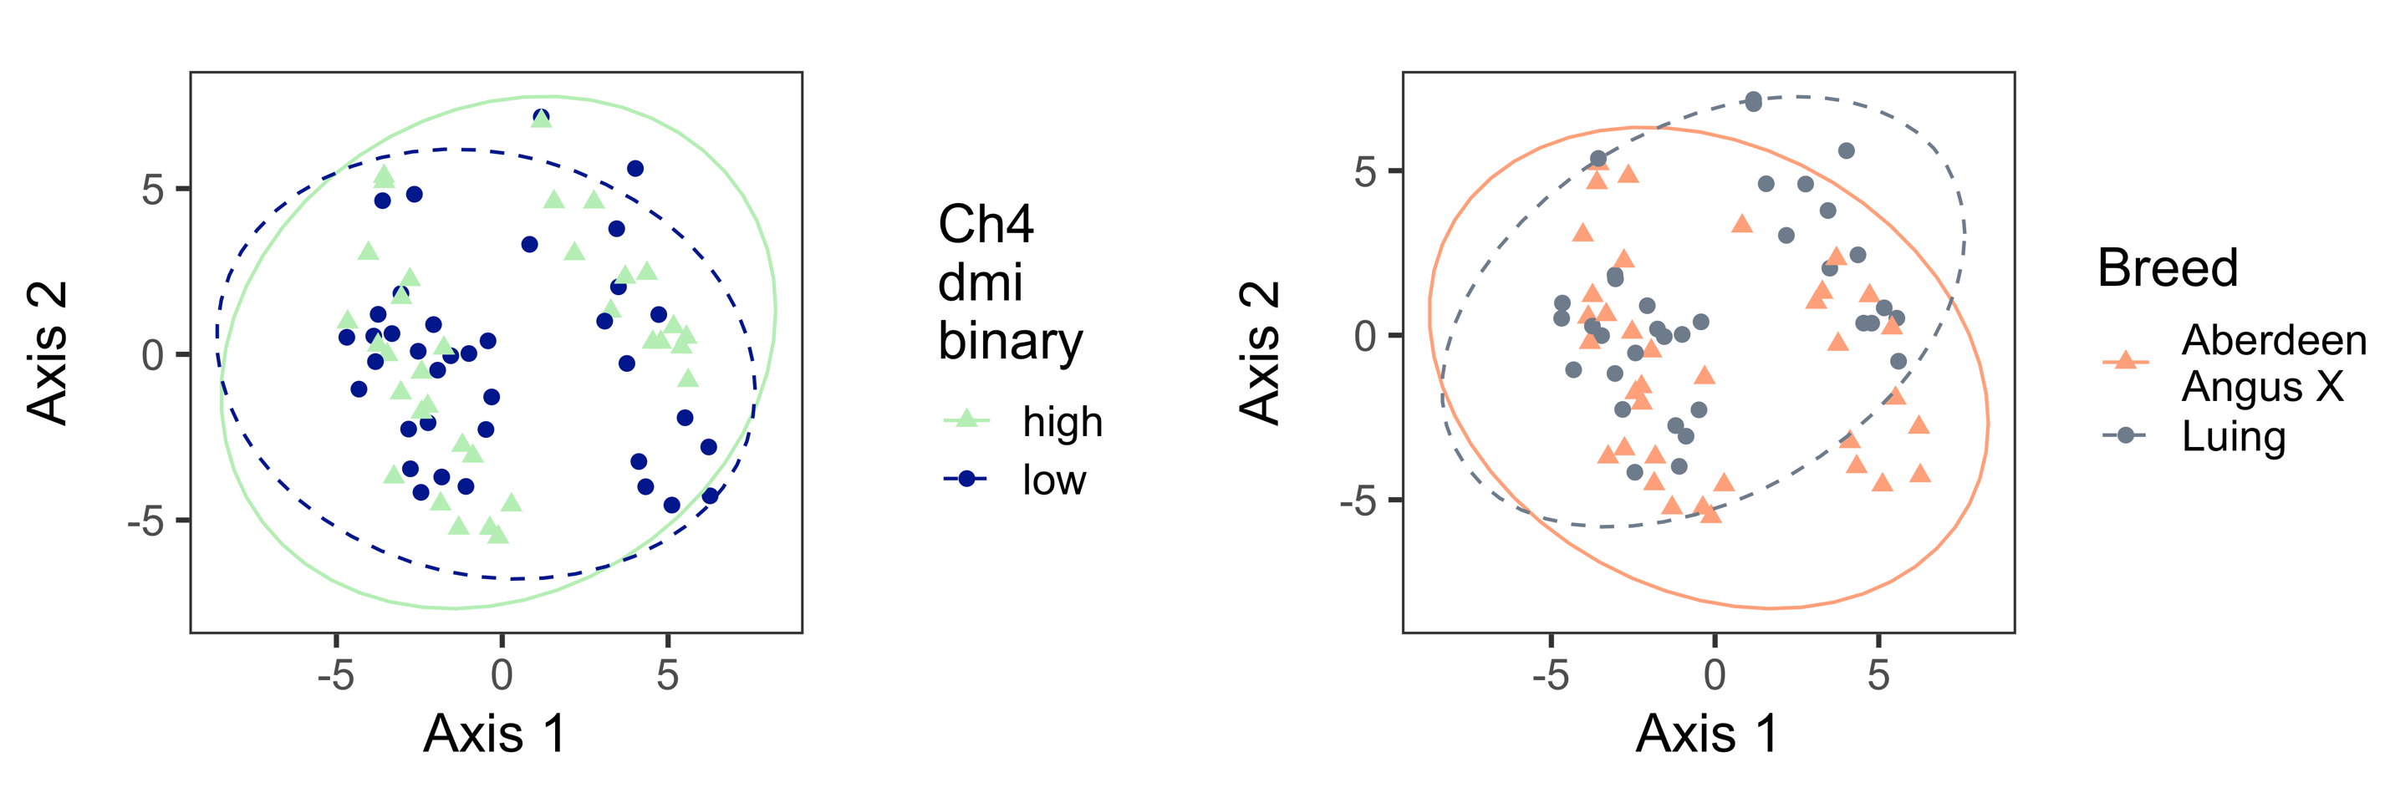
71 Bulls, digesta 16S rRNA sequencing
Notes:
We started looking into obvious effects.
Methane on the left - evenly spread on both sides.
Breed on the right- evenly spread as well.
We didn't want to believe that this was a biological effect. Because there are so many reasons that it could be confounded by something else. Or even just be, a batch effect.
-

Slide 7
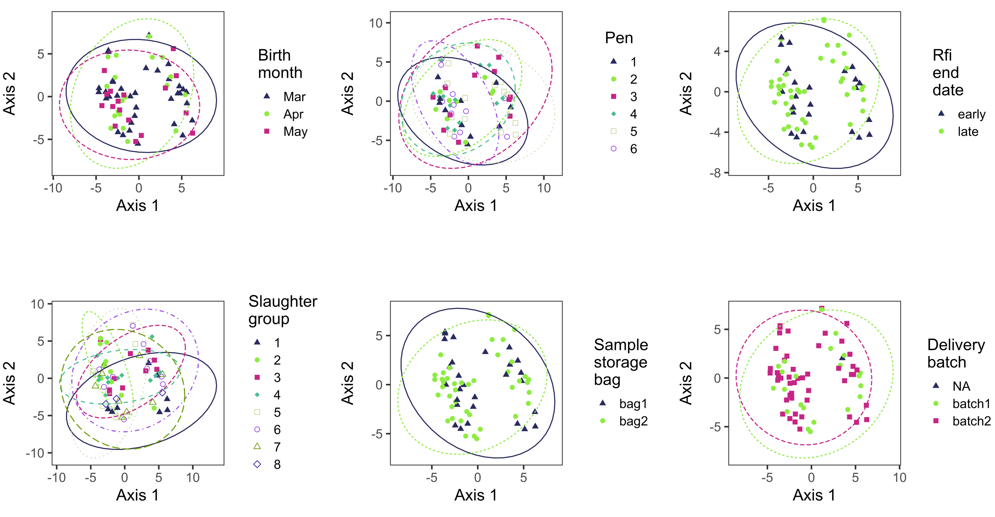
71 Bulls, digesta 16S rRNA sequencing
Notes:
We had a lot of batch variables, which I'm showing the data for here.
Pen - how the bulls were housed.
Residual Feed Intake - how much they ate.
The slaughter group - in which batch they were slaughtered.
Even in which bag the samples were stored, in our freezer.
And how they were delivered.
No explanation of The Split.
Hmm?
-

Slide 8
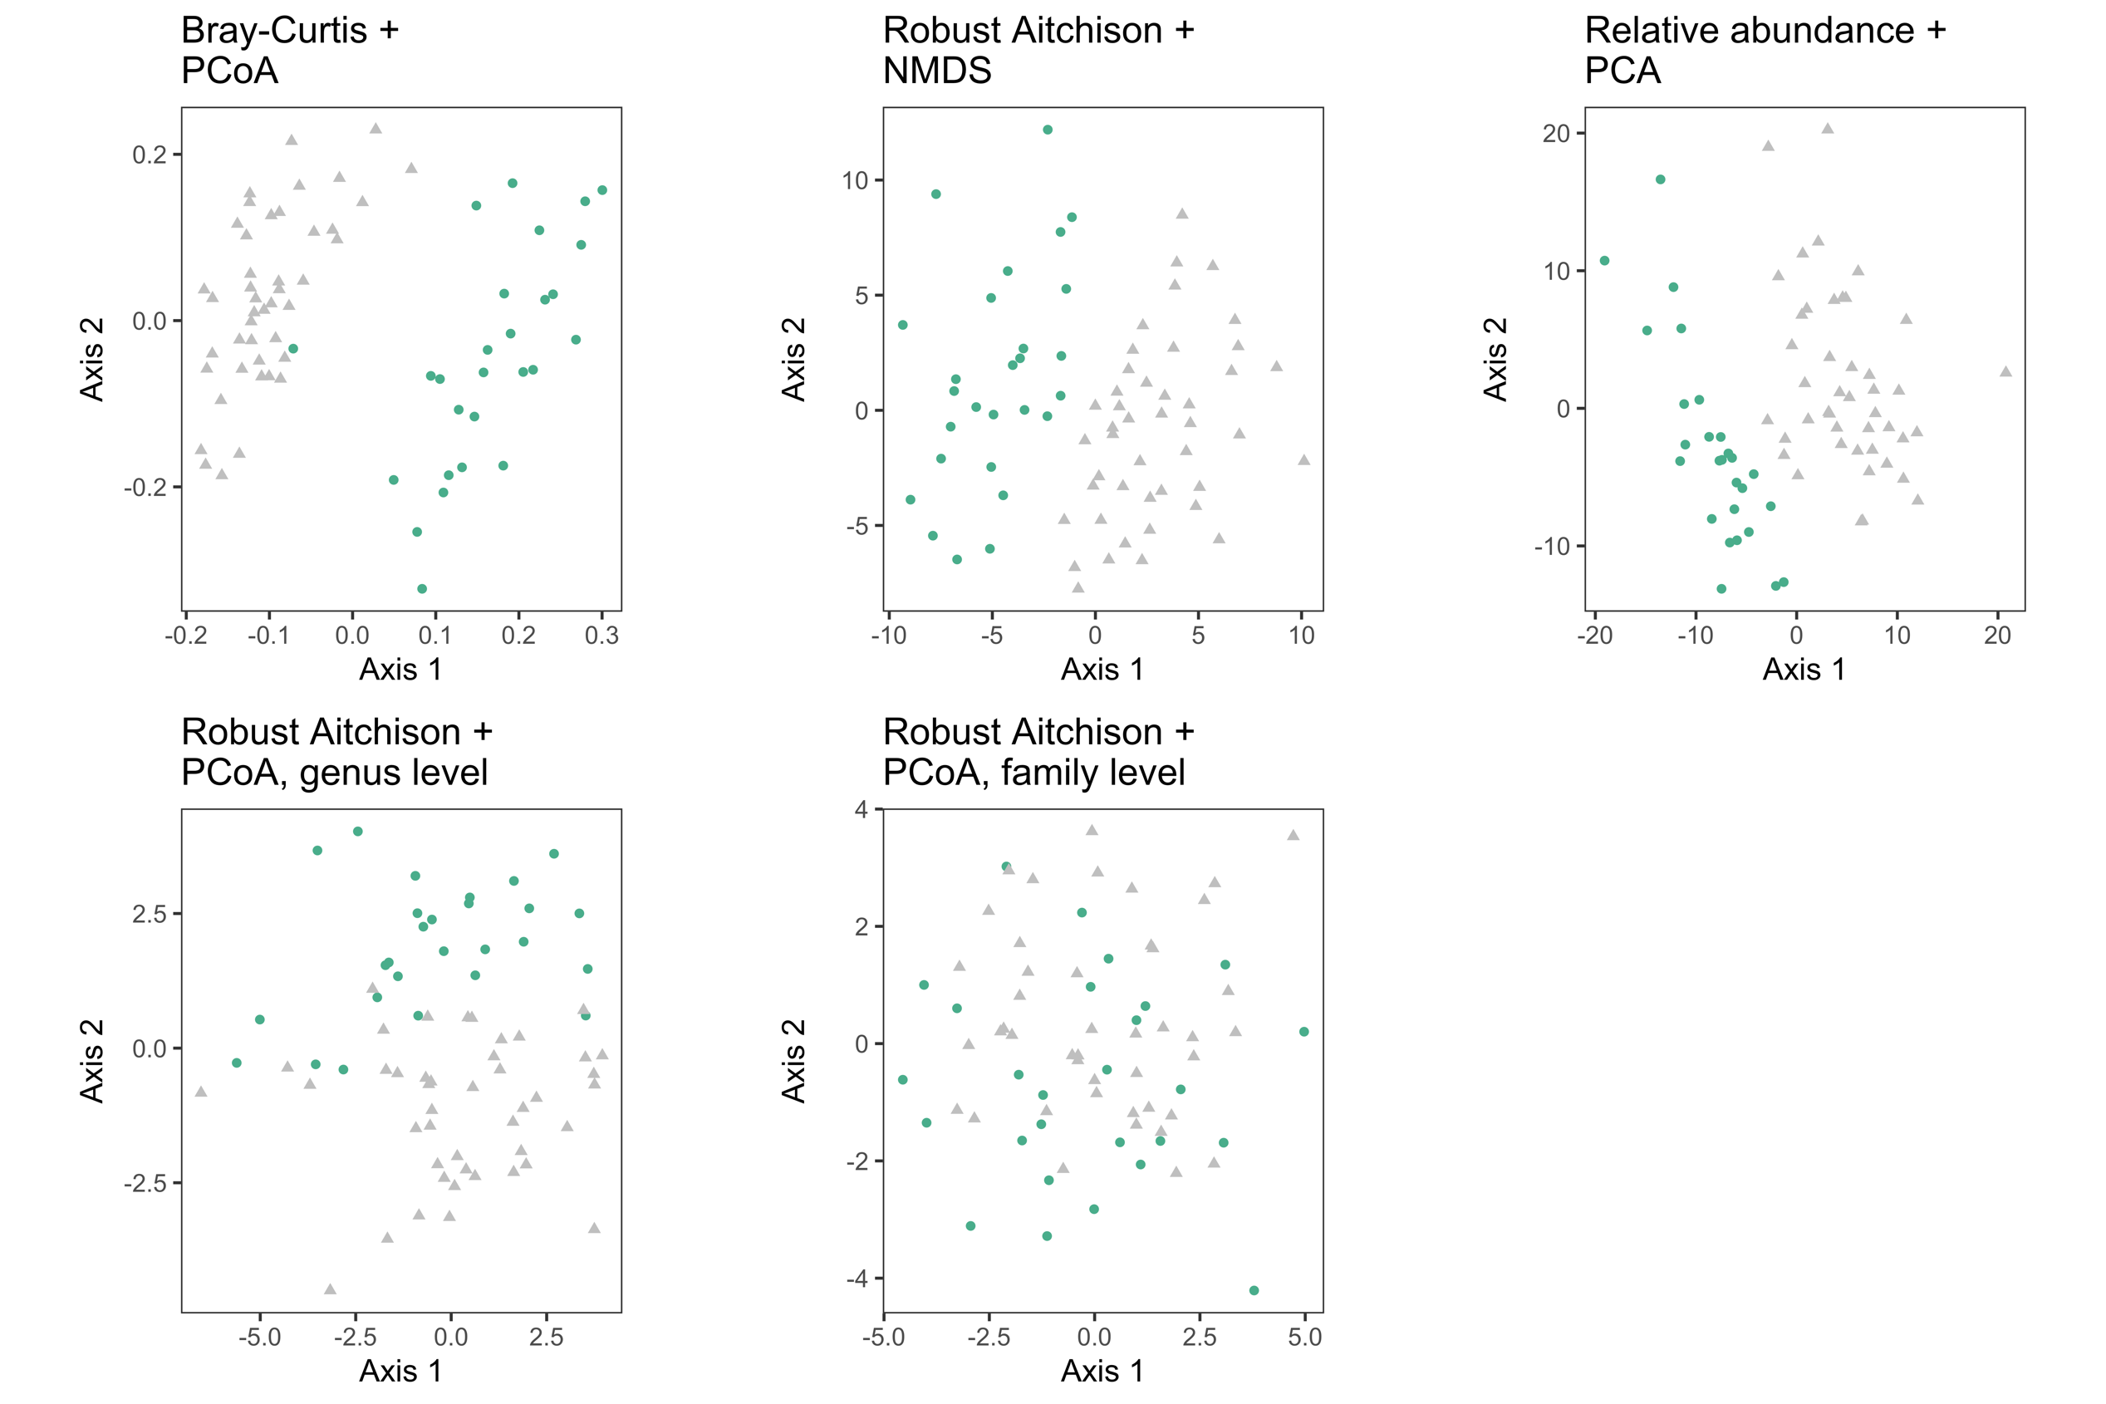
71 Bulls, digesta 16S rRNA sequencing
Notes:
Critically, we also tried summarizing the abundances on the genus or family level.
There still is some indication of the clusters on genus level, but it disappears on the family level.
A possible biological factor, depending on the finer taxonomic details?
-

Slide 9
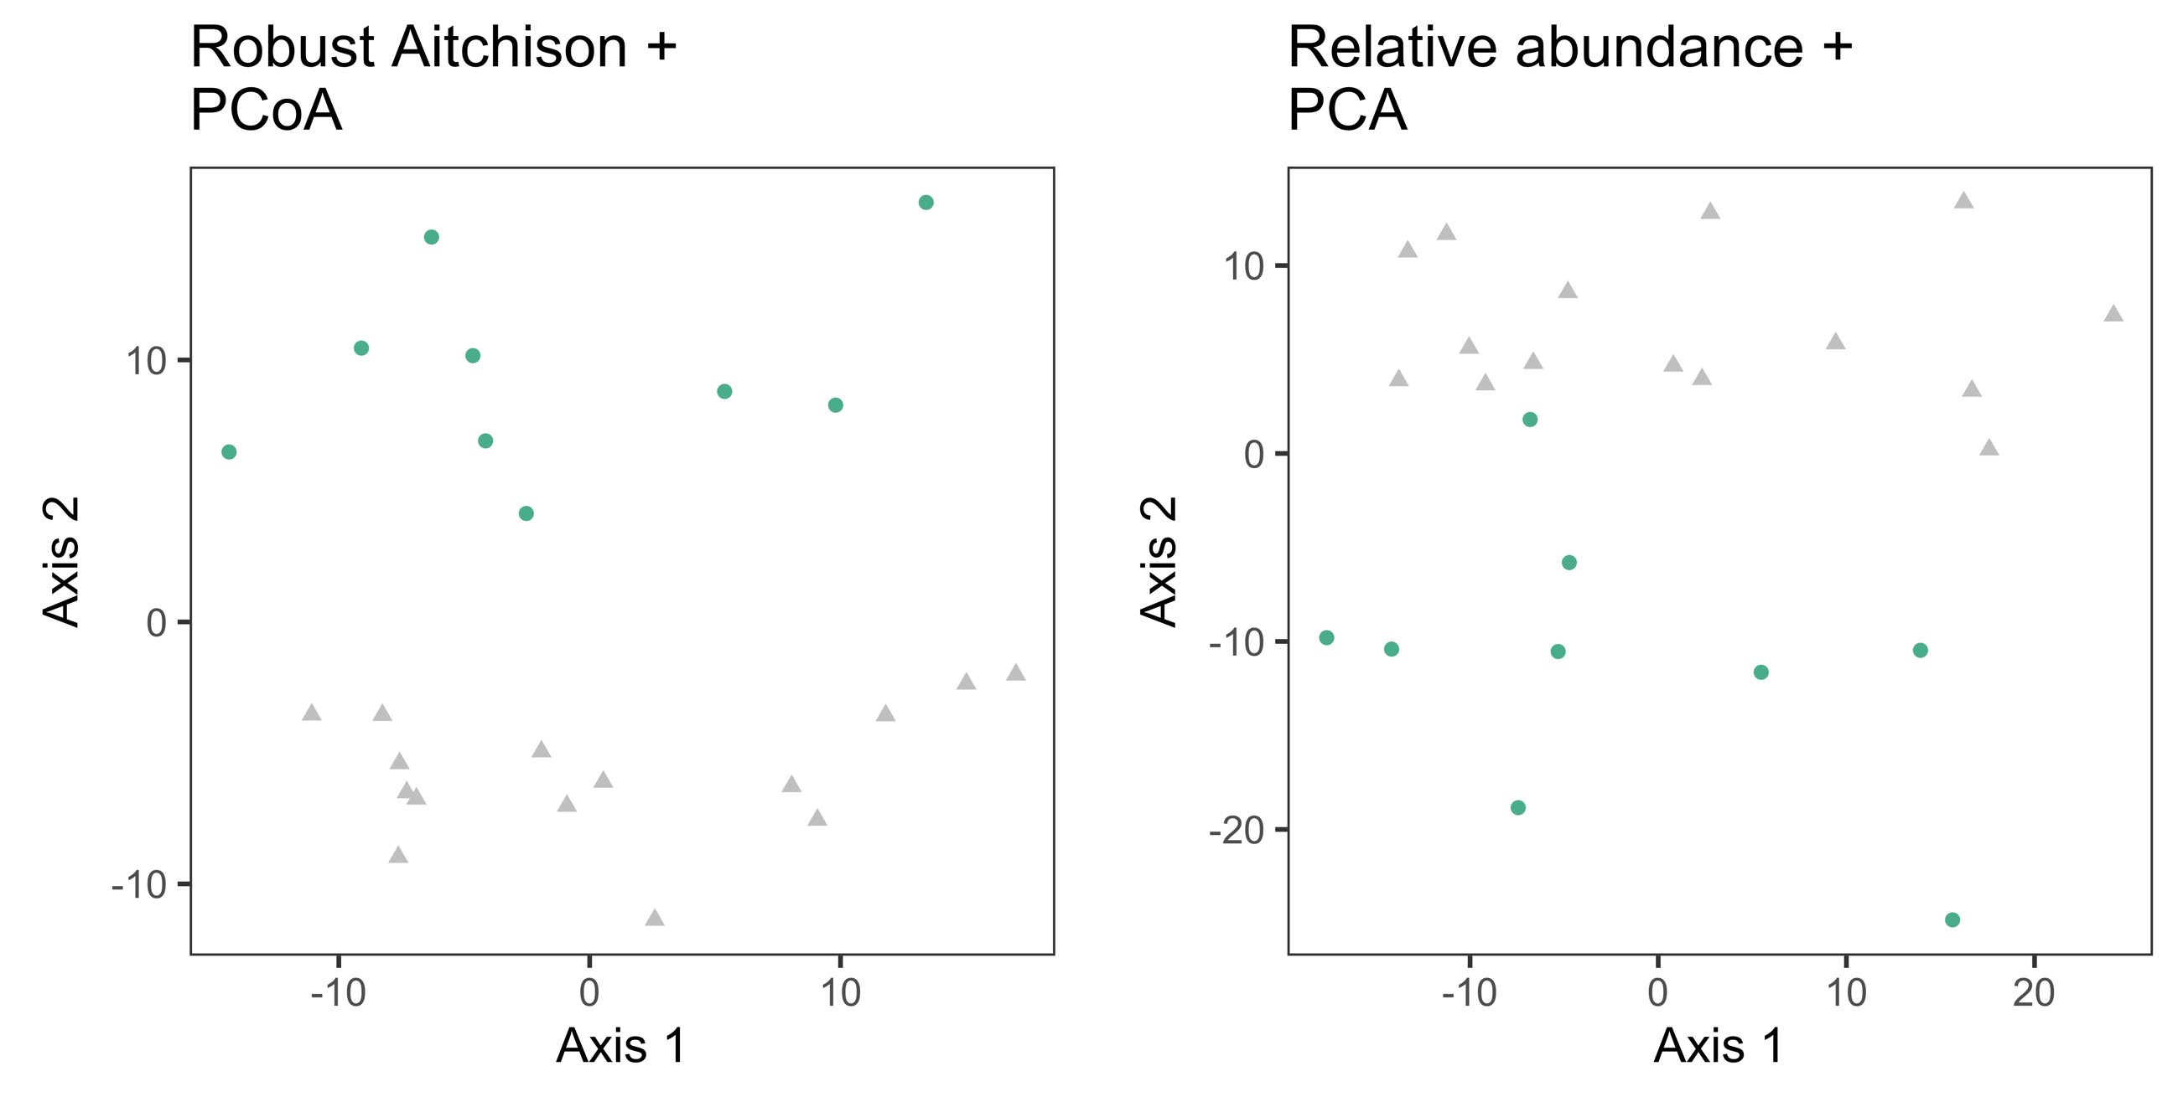
24 Bulls, digesta MAG abundances
Notes:
(tid 3)
What I showed up till now was 16S. What about our MAGs of the microbes?
Guess what - We still see the split clearly.
-

Slide 10
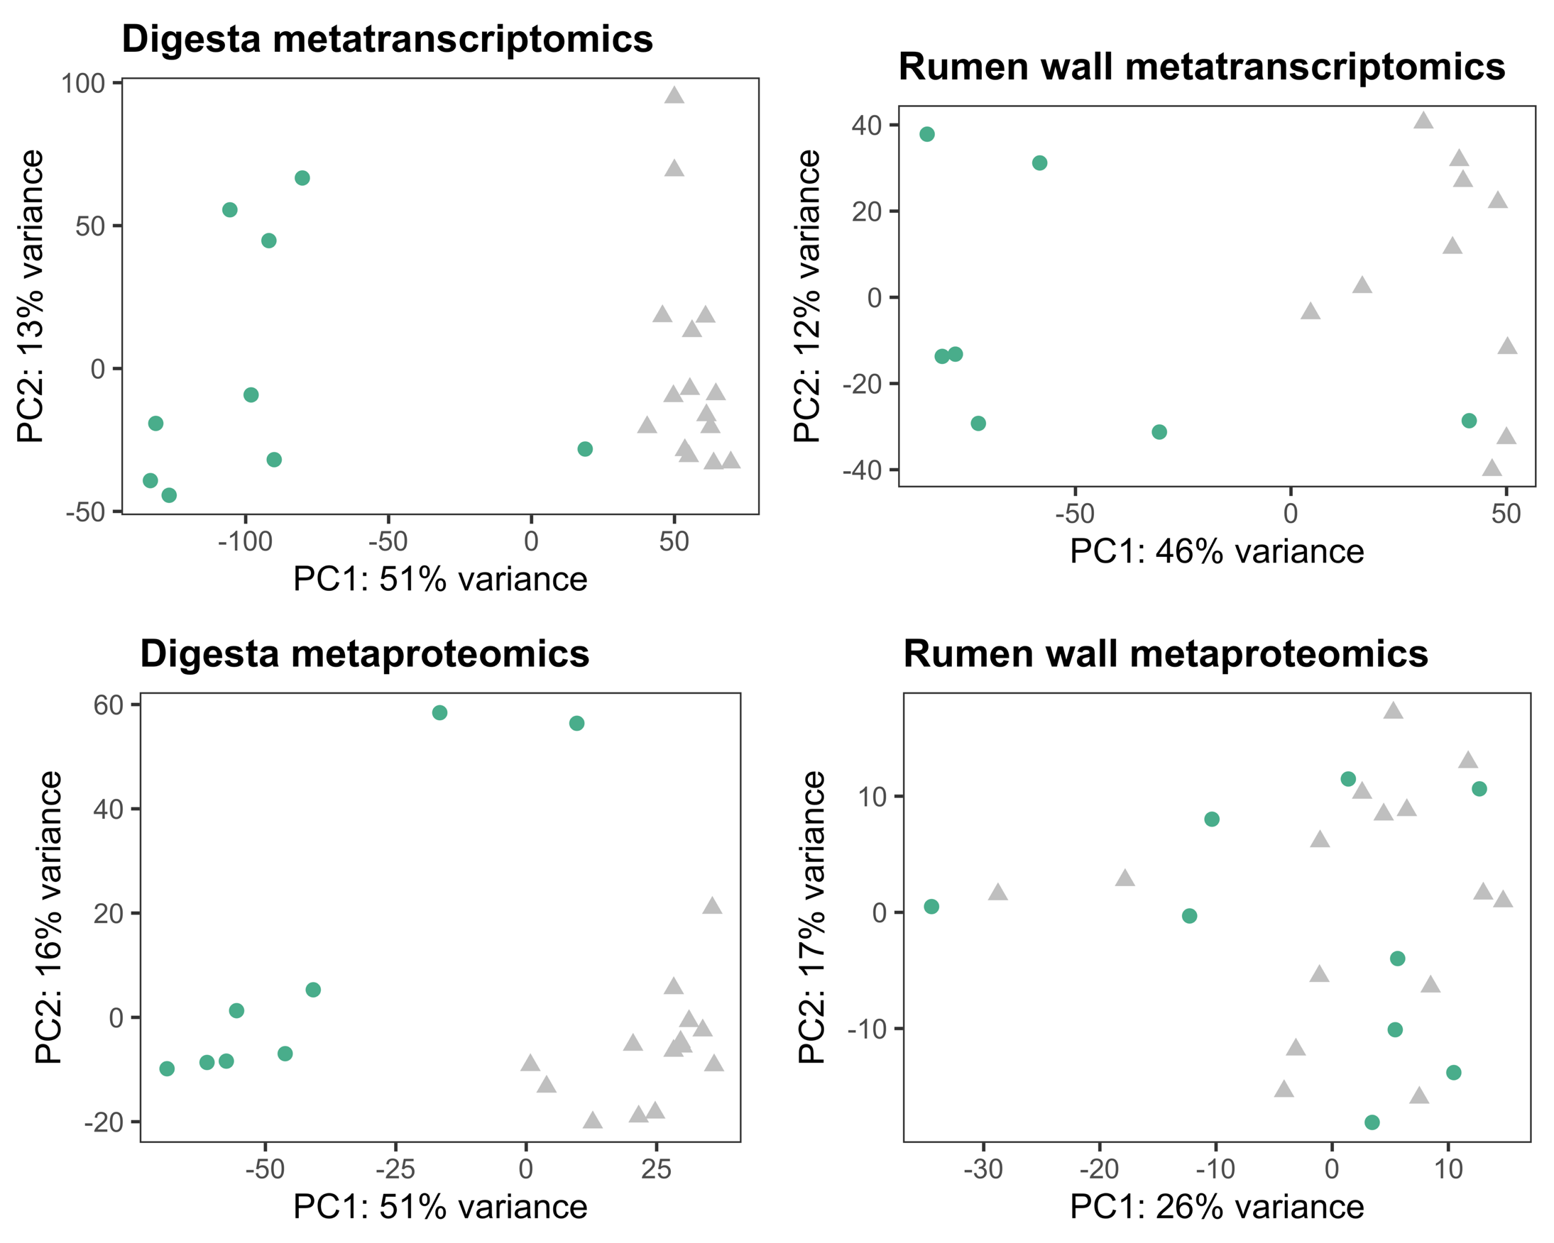
24 Bulls, multi-omics
Notes:
And stepping further into our multi-omics dataset.
Digesta metaT, rumen wall epithelium metaT, digesta metaP and rumen wall metaP.
We see strong signs of The Split.
-

Slide 11
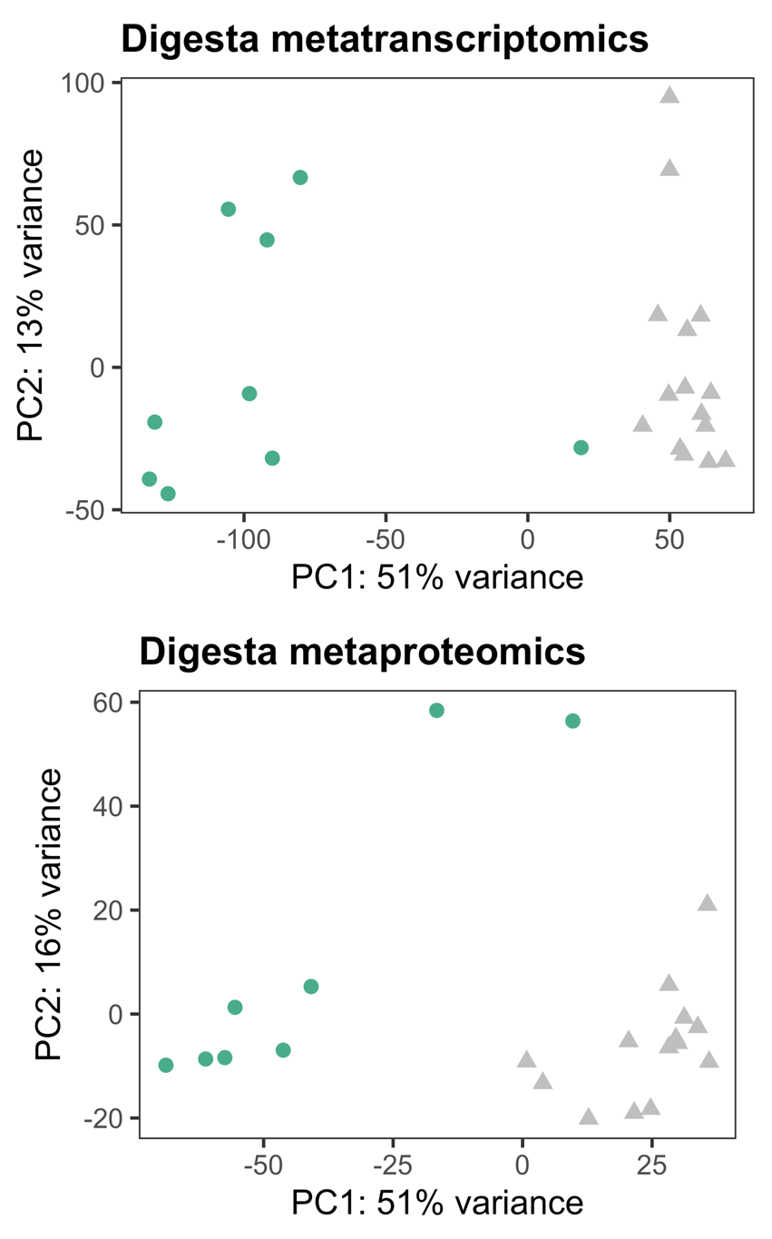
24 Bulls, digesta multi-omics
Notes:
At least in the metatranscriptomics and metaproteomics of the digesta.
-

Slide 12
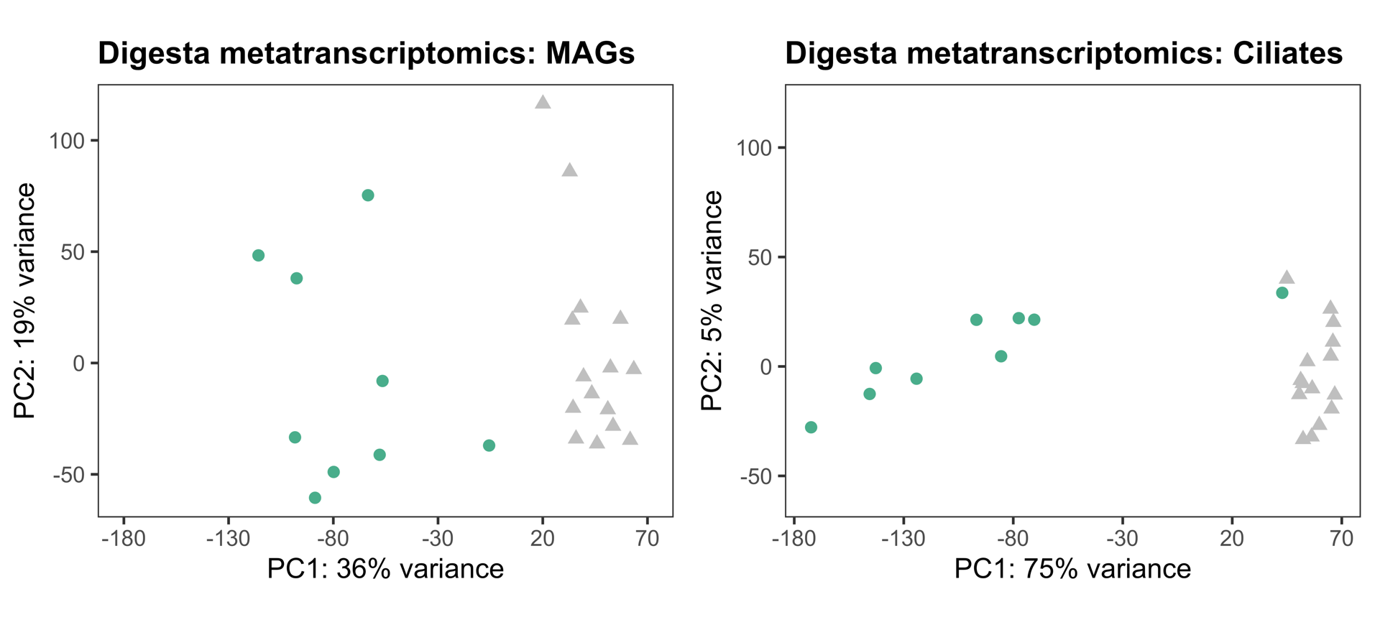

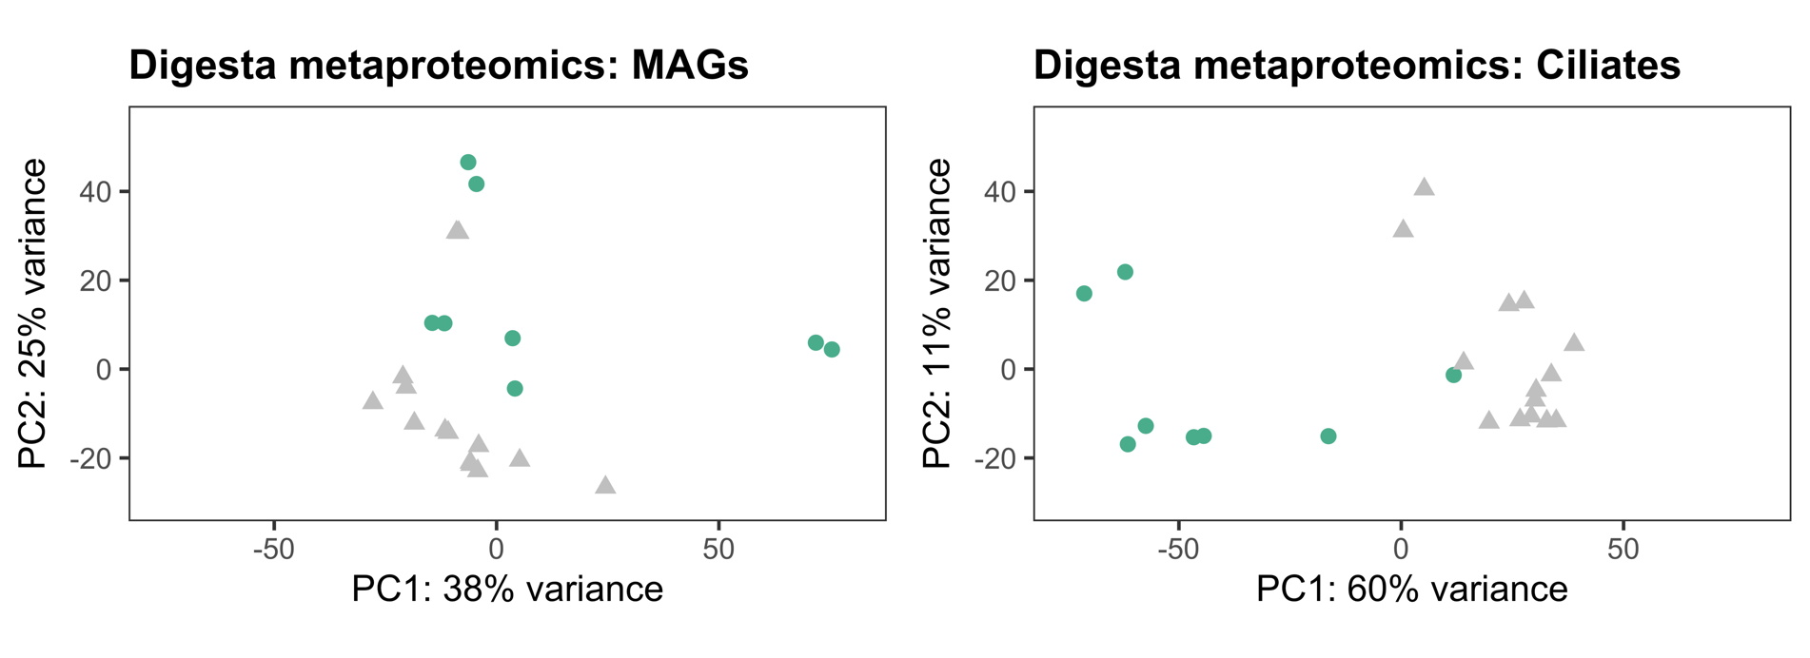
24 Bulls, digesta multi-omics
Notes:
In meta-transcriptomics, top left, the clustering seems clearly present in both MAG and ciliate data.
For metaproteomics, bottom left, there is a bit more overlap between the clusters.
Transcriptomics and proteomics are such different methods. Where proteomics has redundancy issues, transcriptomics is more specific. So the fact that we're seeing the same split across these different methods, is an indication that something biological might be going on.
-

Slide 13
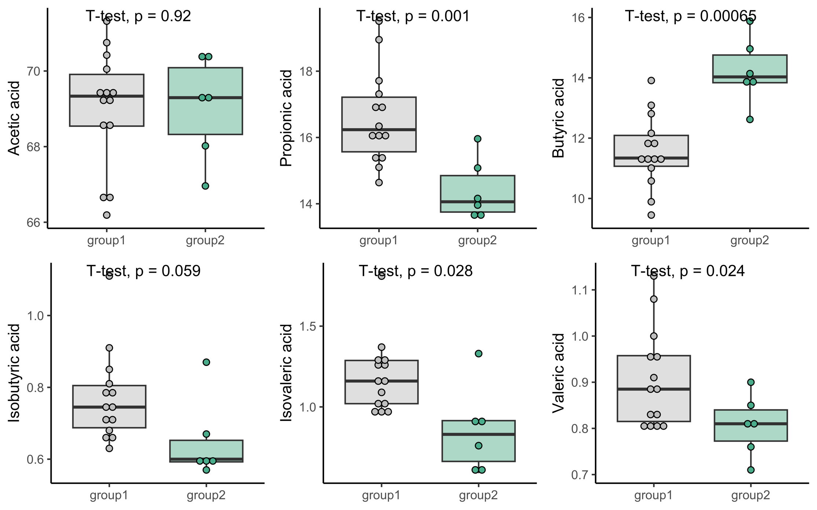
24 Bulls, rumen digesta, targeted Volatile Fatty Acid (VFA) metabolomics
Notes:
(VFA contrasted by The Split)
We also had 6 VFA targets as part of our metabolomics.
We see propionic acid, butyric acid, isovaleric acid and valeric acid being significantly different between these split groups in the digesta of the bulls.
Specifically butyric and propionic acids have a large difference.
VFAs are very important in the energy transfer from feed to host through the microbiome, so this is another hint, that something biological is lurking in The Split.
-

Slide 14
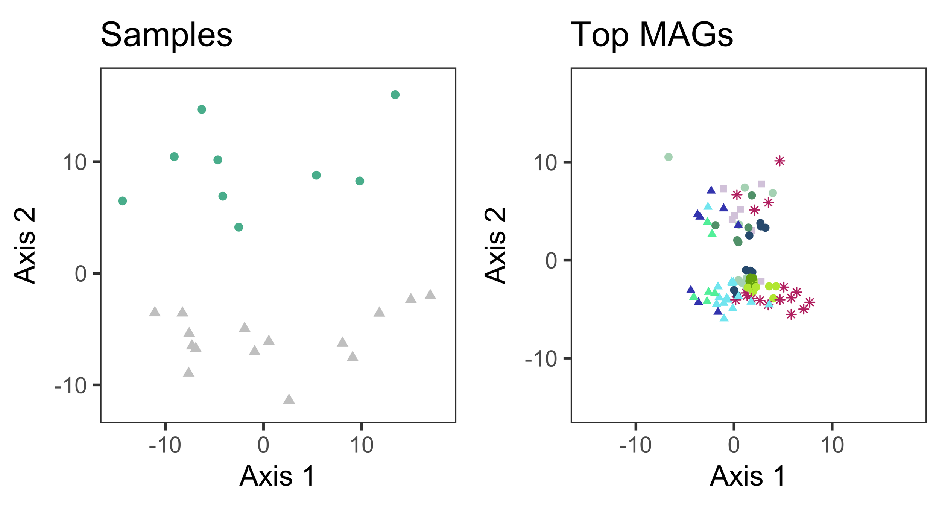
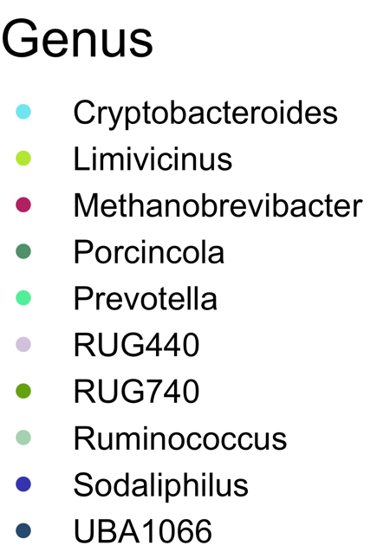
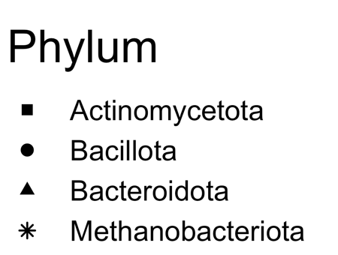
24 Bulls, rumen digesta MAGs
Notes:
So we know that this is not a batch or technical effect. So what is it then?
This is a MAG abundance PCoA bi-plot, showing samples (bulls) as well as those MAGs that differ significantly between the two clusters, trimmed to genera with more than 5 significant MAGs, with taxonomic details provided.
What is interesting is that we see that the influential MAGs driving the split seem to often represent different strains of the same genus - there are several Methanobrevibacter and Sodaliphilus MAGs on both sides of the second axis.
-

Slide 15
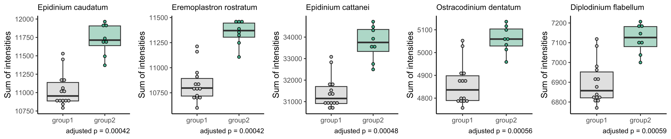
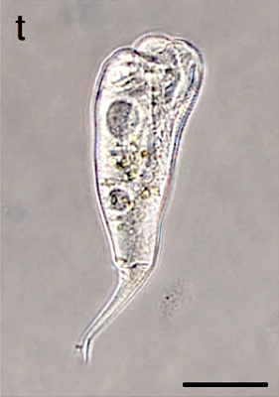
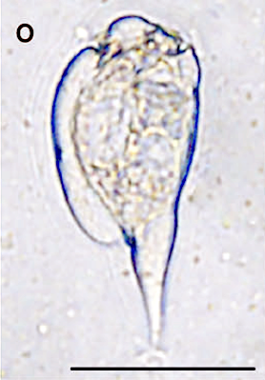
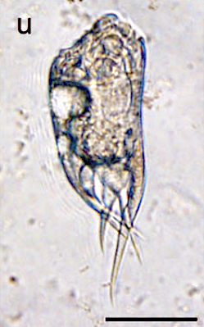
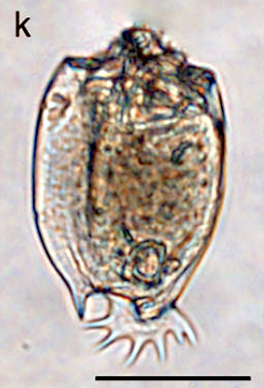
24 bulls, digesta rumen proteomics,
Protein biomass per species
Light micrographs from Li et al 2022, ISME J. Bars are 50µm.
Notes:
(tid ~5:10)
We think, maybe the Ciliates are taking part in driving this as well.
We saw in the digesta metaT and metaP that the ciliates follow The Split.
Here are the 5 ciliate species that differ the most between the two clusters. All are increased in group2.
These ciliate genomes are booming with fibre degrading cazymes. They play an important role in fermentation and butyrate production.
-

Slide 16
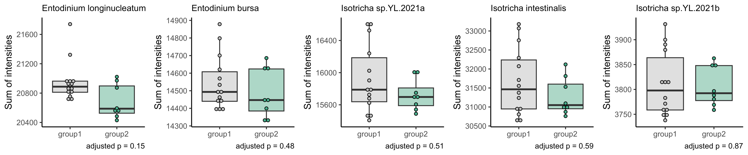
24 bulls, digesta rumen proteomics,
Protein biomass per species
Notes:
For comparison, only these 5 ciliate species have a numerically higher abundances in group1, but none of them are significantly different between groups.
These ciliate genomes are booming with fibre degrading cazymes. They play an important role in fermentation and butyrate production.
-

Slide 17

24 bulls, digesta rumen proteomics,
WGCNA protein eigengenes, correlated to The Split
Protein Eigengene / Split
Correlation coefficient
Notes:
(Quick intro to holo-omic modeling using WGCNA)
Using several different methodologies is a good way to validate ones results, so we looked into network analysis to see if we could observe and further characterize The Split.
This overall problem that we're faced with is reminiscent of the needle-in-the-haystack problem.
We have an absolute haystack of information, and we need to find the needle -- the biological signal that drives this split.
So we used WGCNA -weighted gene co-expression network analysis- which is a framework that does hierarchical clustering to group the proteins into clusters. For each of these clusters, principal component analysis, roughly, is applied to define so called eigen proteins, which are idealized proteins that capture the main variation within each of these clusters.
To these clusters -or eigen proteins hereof- we can correlate our KPIs and metadata. What you see here are all digesta eigen proteins correlated to The Split variable.
-

Slide 18
24 bulls, digesta rumen proteomics,
WGCNA protein eigengenes, correlated to The Split
Protein Eigengene / Split
Correlation coefficient
Protein eigengenes positively
correlated ..
.. & negatively correlated to the split.
Notes:
If we then take the top 5% most correlated proteins in these modules, and summarize which species they come from, we get something that looks like --> this →
-

Slide 19
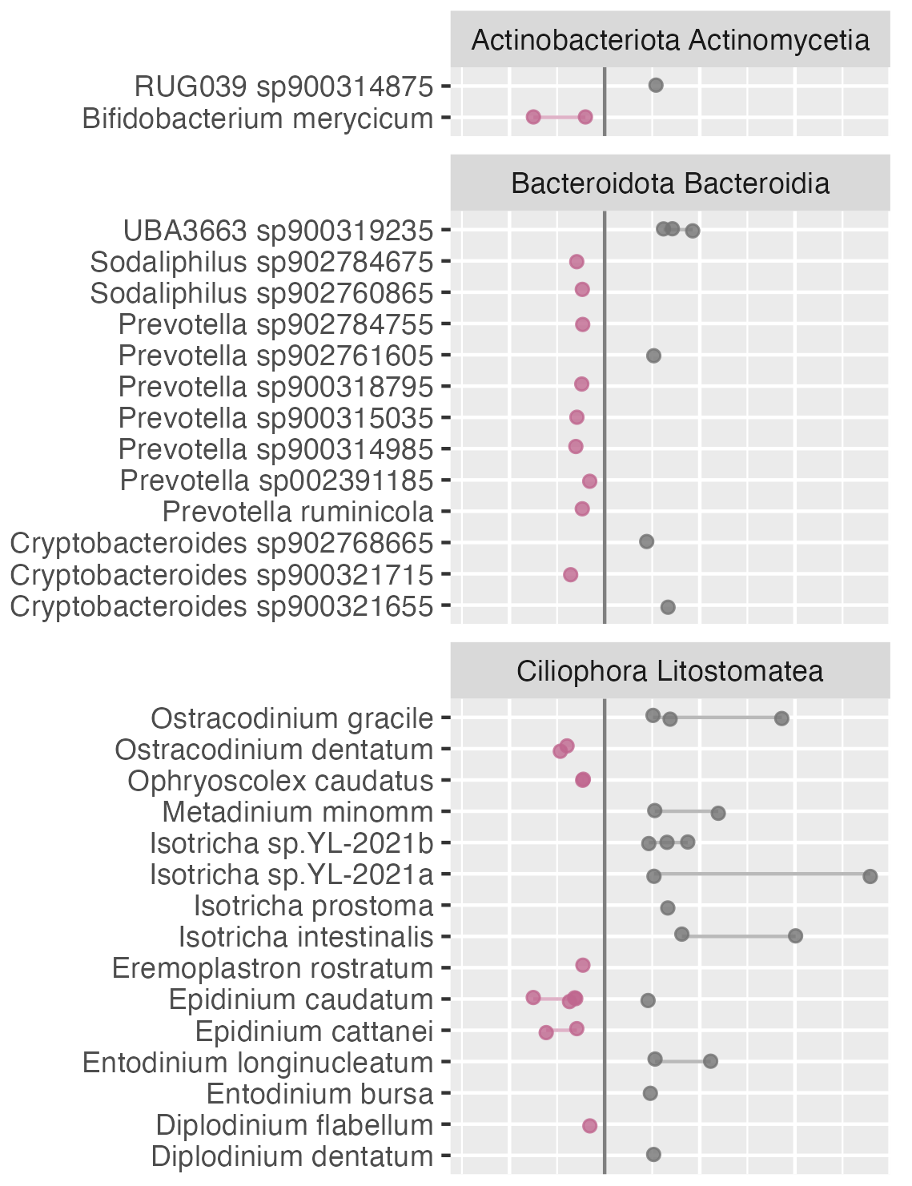
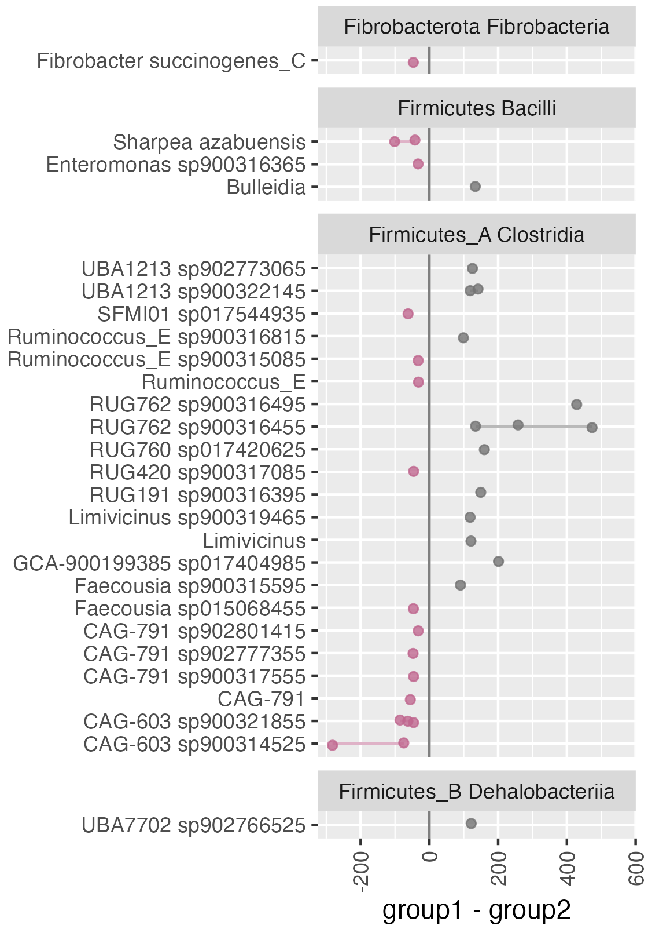

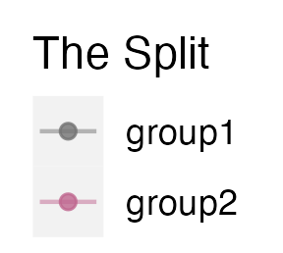
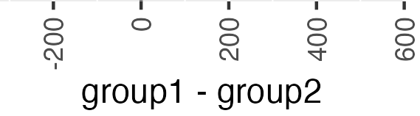
24 bulls, digesta rumen proteomics,
Sum of normalized intensities from The Split correlated digesta WGCNA modules
Notes:
The clades in the panes are phylum and class, and the names next to the dots are genus and species.
What we see is that there is a great overlap of these results with the metagenomic split results. Let me annotate which ones are overlapping. →
-

Slide 20
24 bulls, digesta rumen proteomics,
Sum of normalized intensities from The Split correlated digesta WGCNA modules
Notes:
So these are the Bacteria that overlap with the MAG abundance PCoA of the metagenomes.
-

Slide 21
24 bulls, digesta rumen proteomics,
Sum of normalized intensities from The Split correlated digesta WGCNA modules
Notes:
And additionally, these are the Ciliates that I've already glossed over. Isotricha and Entodinium in group1, and Epidinium in group2. Which is exactly what we've already seen. Here it looks specifically like Isotricha plays a large role.
Again. This is a completely different approach, but we find many of the same species as with the MAG abundance PCoA, at least for the bacteria.
-

Slide 22

Take-home
Two clusters.
No technical/batch explanation.
Good reason to believe that this is biological due to:
  Separation specifically beyond the genus level.
  Pervasiveness across omic layers.
  Link to high biomass ciliates which are known to affect VFA metabolism.
A need for a generalized gold standard pipeline to investigate complex possible holo-omic interactions in holo-bionts.
Velma T. E. Aho
Notes:
(Take-home)
So this is the take home.
Two clusters, and good reason to believe that it is biological.
There is a need to find the gold standard for integrating the multi-omic layers of holo-omic studies.
One approach could be to generalize a workflow that can correlate the principal components of variation across multi-omics layers and highlight metabolic function across a wide array of databases like we did here. Some of these tools already exist.
But the problem is that databases are often limited and too species specific to capture the variation of complex holobionts. Maybe we should start with generalized databases with metabolic function and build from there.
Finally, I want to give a special shout out to my colleague, postdoc Velma Tea Essi Aho who did a lot of work to characterize the variation and to test for possible batch and technical effects. She will present this more in depth at ISME in South Africa, less than two months from now.
-

Slide 23
Discussion &
questions?
CGIF presentation by
Carl Mathias Kobel, PhD fellow at MEMO/NMBU
For contact and more
carl.mathias.kobel@nmbu.no
https://cmkobel.github.io/
Notes:
Now I will open the discussion and questions part of my presentation. I must say, these are preliminary data, and we're still trying to figure things out. But let me know what your ideas and questions are.
---
standard answer #1: This is preliminary data and we're still working on this. We also still have more questions than answers.
#2: A reason why ciliates can sustain such a large biomass is because they predate on prokaryotes. And there are signs of predation in the proteomic results.
-

